Slide 1
AWSMLDataprep

Slide 2
Data prep
Cleaning, Scrubbing, Sanitizing
Sometimes we need to convert text to number, fix inaccuracies
Prepare for model training and testing
Categorical Encoding – converting text to numbers
Feature Engineering – transforms features to make them relevant to ML algorithms
Handling missing values – removing incomplete, irrelevant, duplicated data

Slide 3
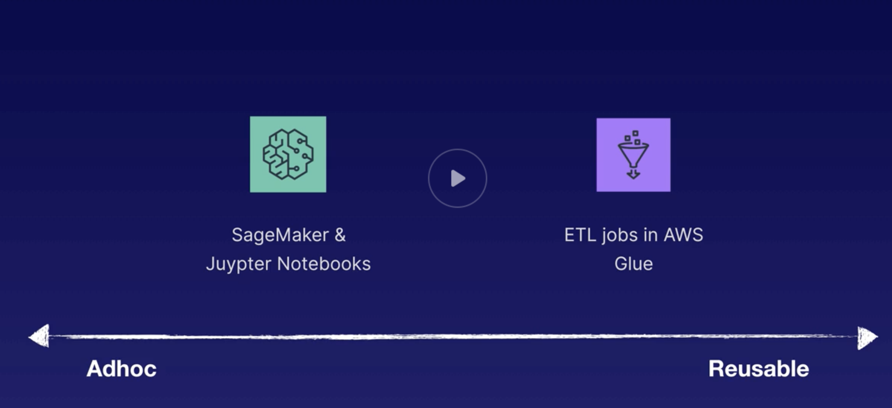
What tool to use?
ETL jobs – AWS Glue

Slide 4
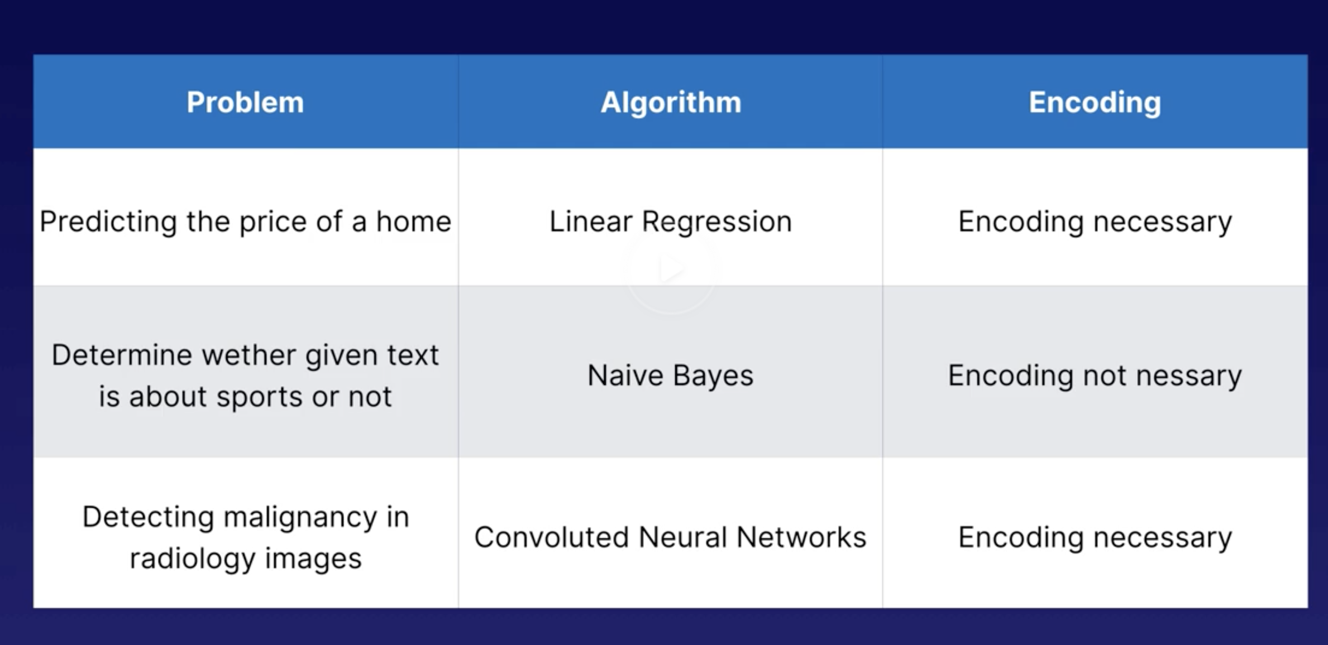
Categorical Encoding
Depending on which algo is needed, we need to encode or not

Slide 5
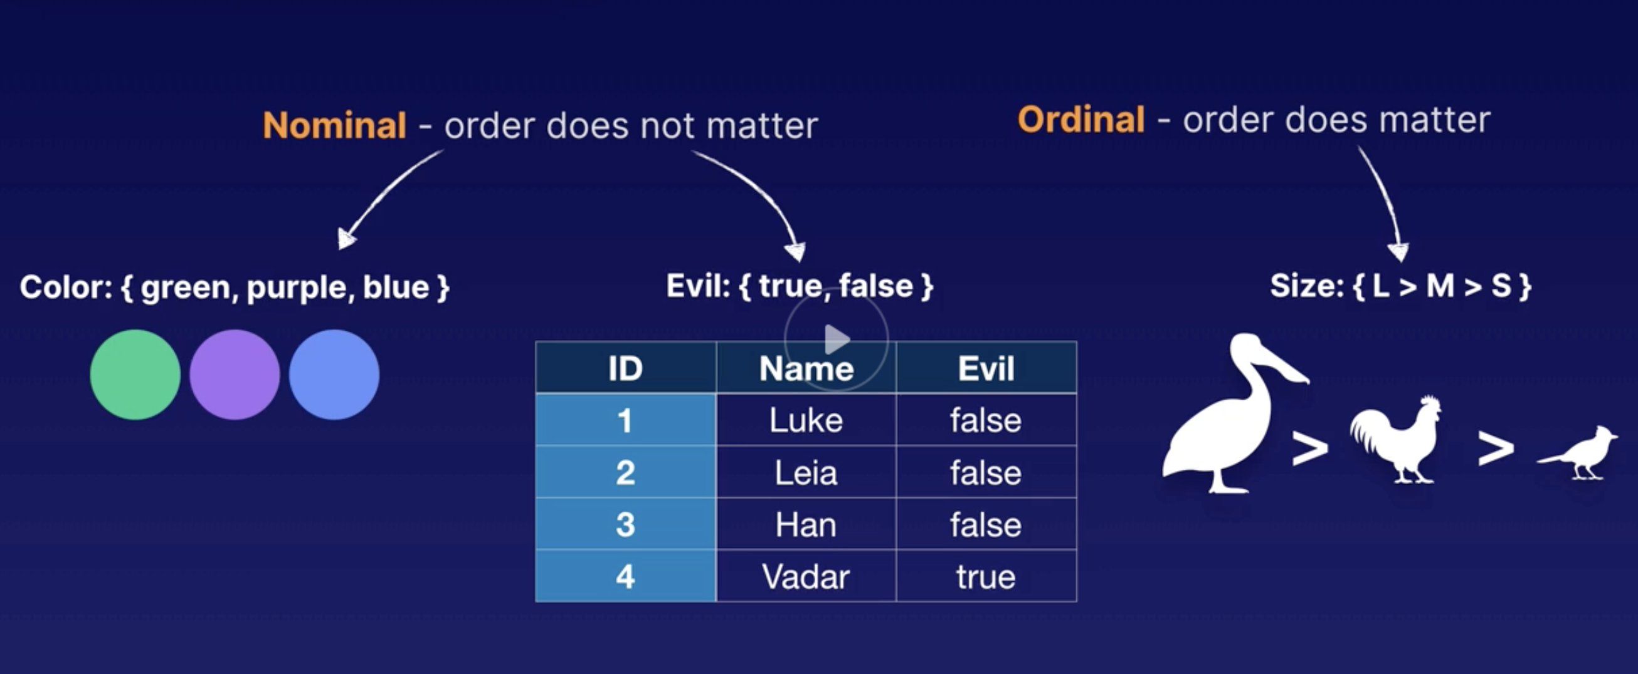
Examples
Nominal – order does not matter
Ordinal – order does matter

Slide 6
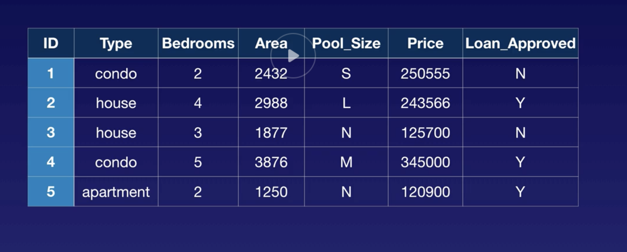
Data set – Home data

Slide 7
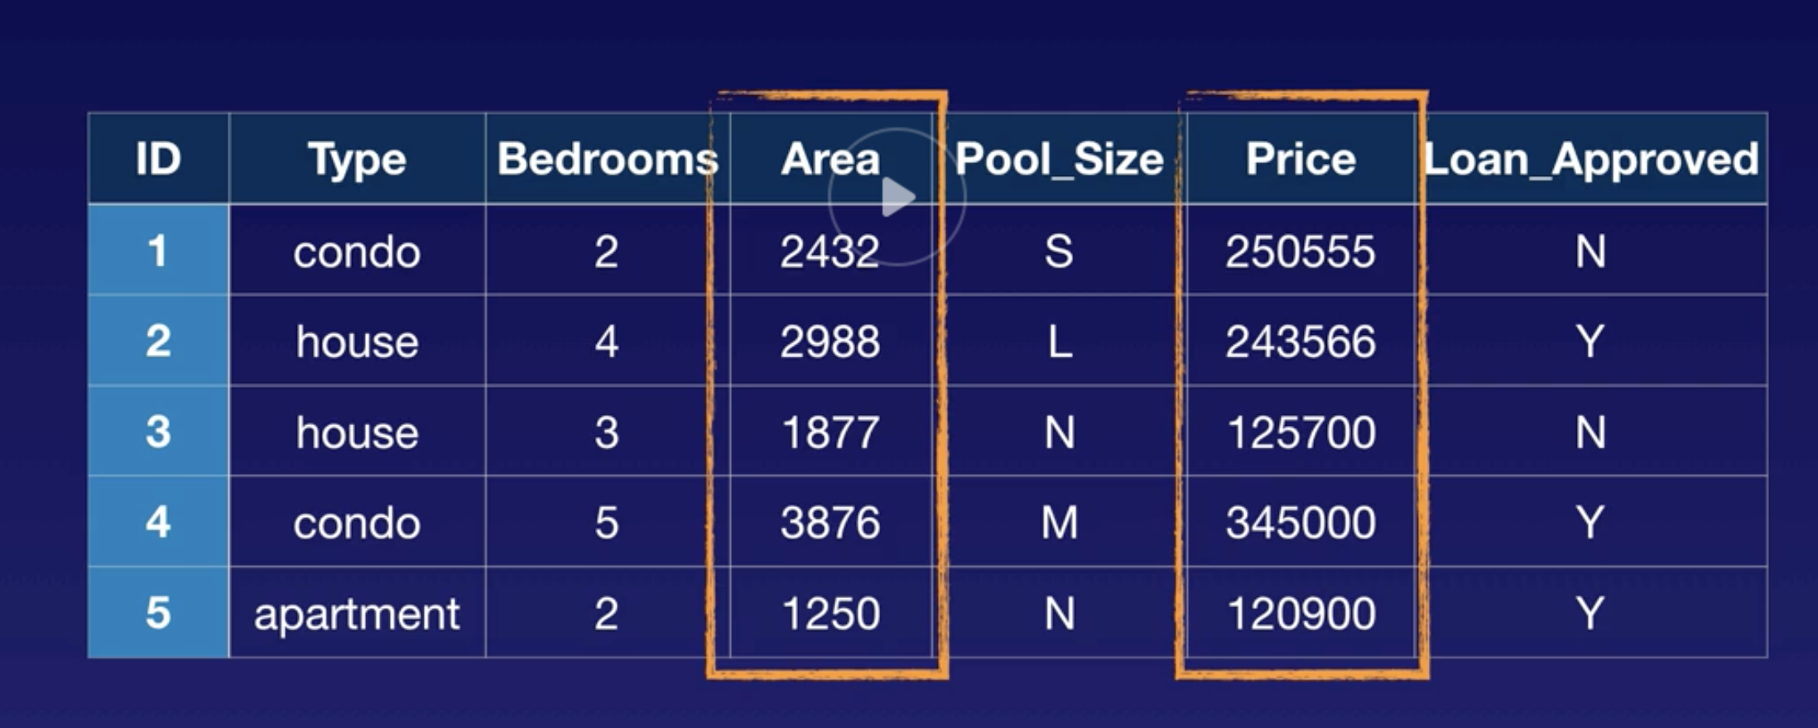
Continuous data points - no encoding needed

Slide 8
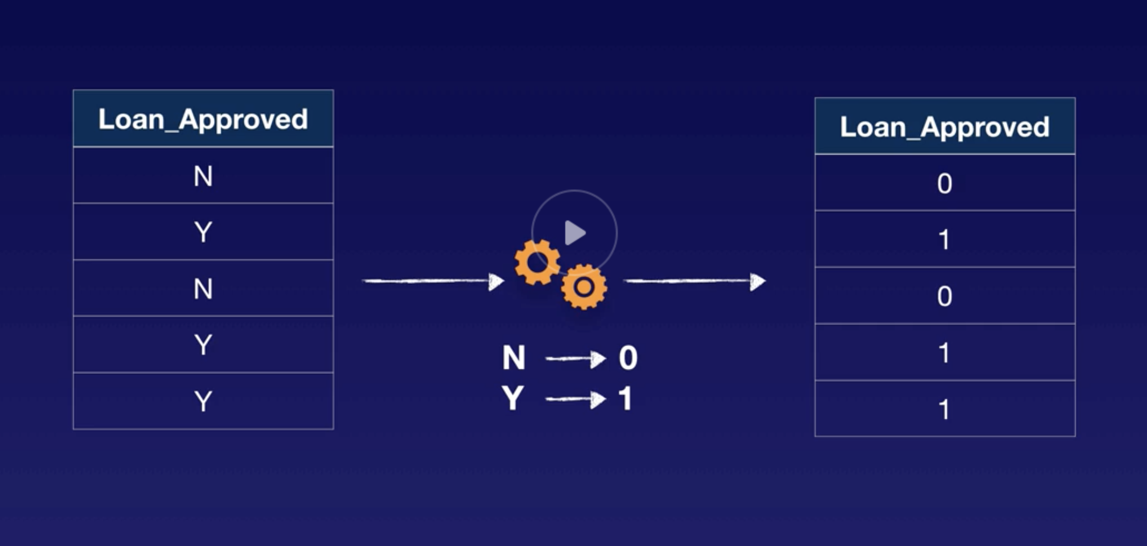
Loan approved target attribute needs encoding

Slide 9
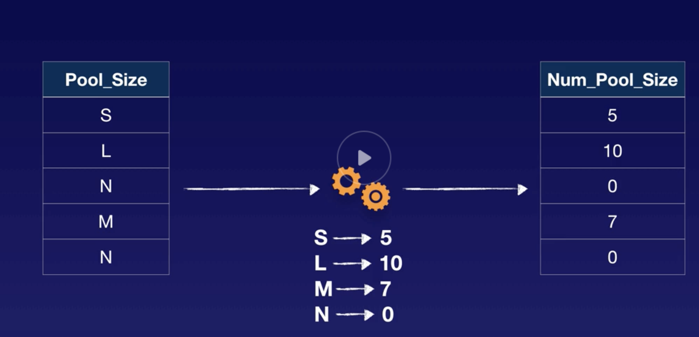
Ordinal data points need mapping

Slide 10
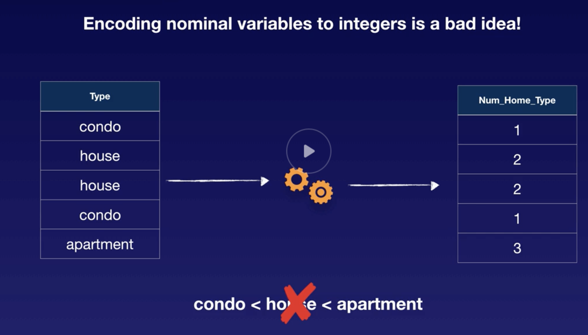
Encoding nominal data points is a no-no

Slide 11
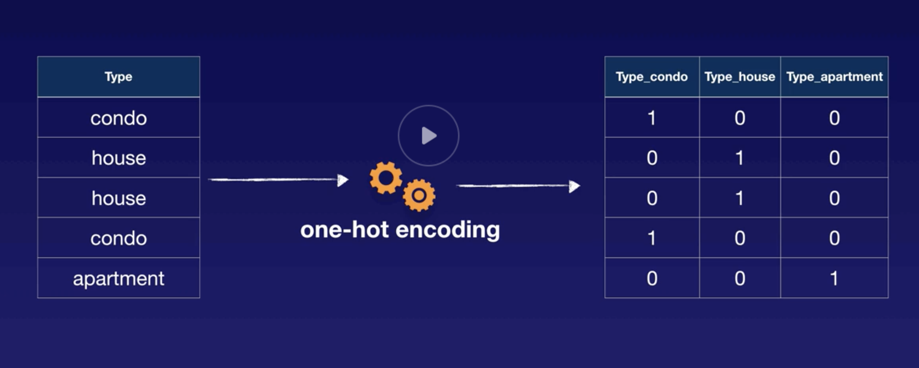
Instead so one-hot encoding
Create features for each type
May not work well for many types – would need grouping

Slide 12
Text feature engineering
Changing features or attributes in data
Getting them ready for the model
Text feature engineering:
Transforming text to data so ML algorithms can better analyze it
Splitting text into bite size pieces
Transformed data used in: NLP, speech recognition, text to speech

Slide 13
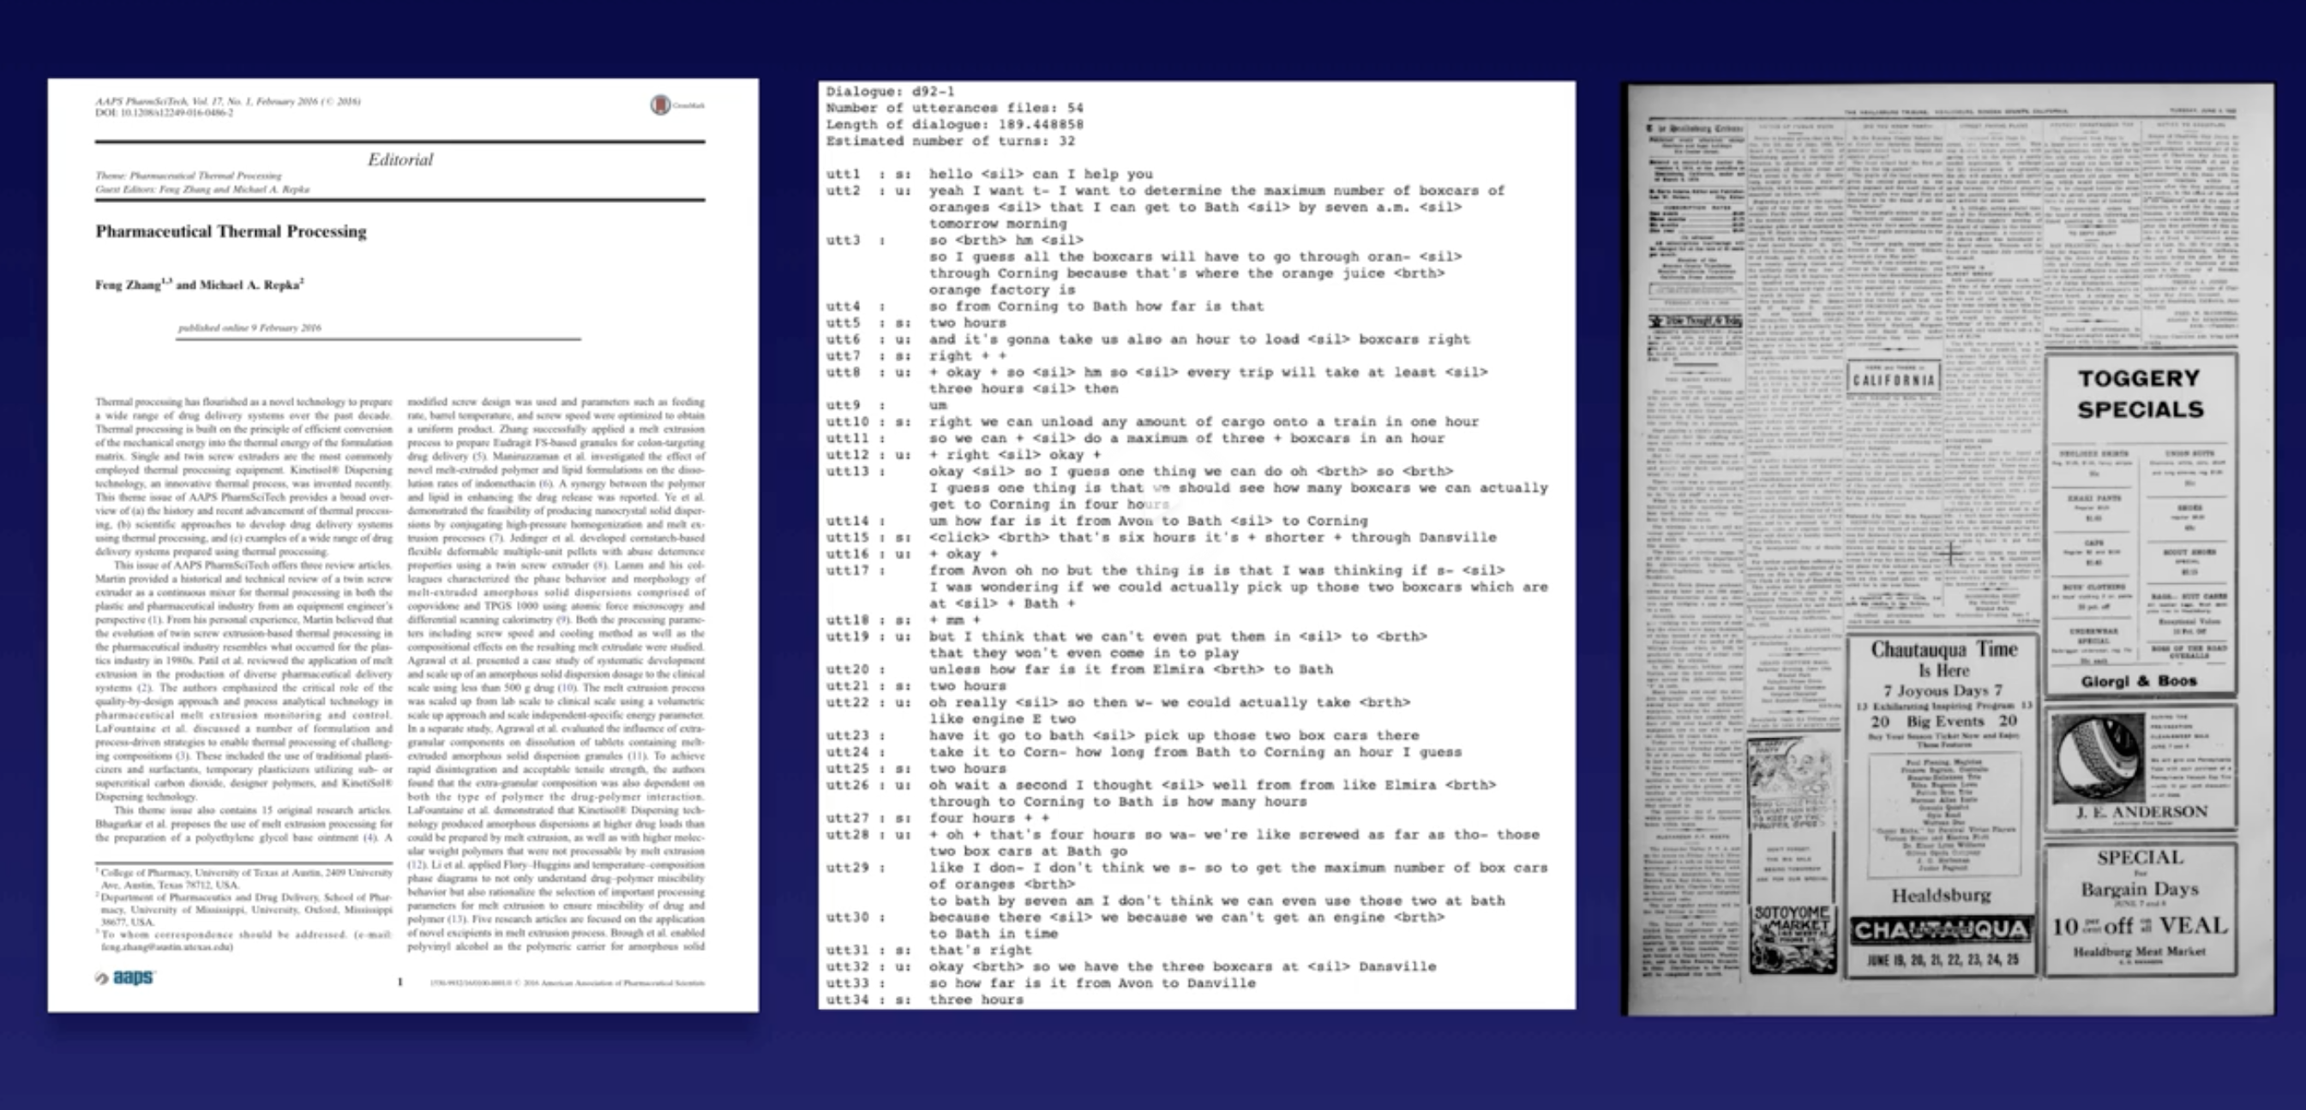
Examples of text data

Slide 14
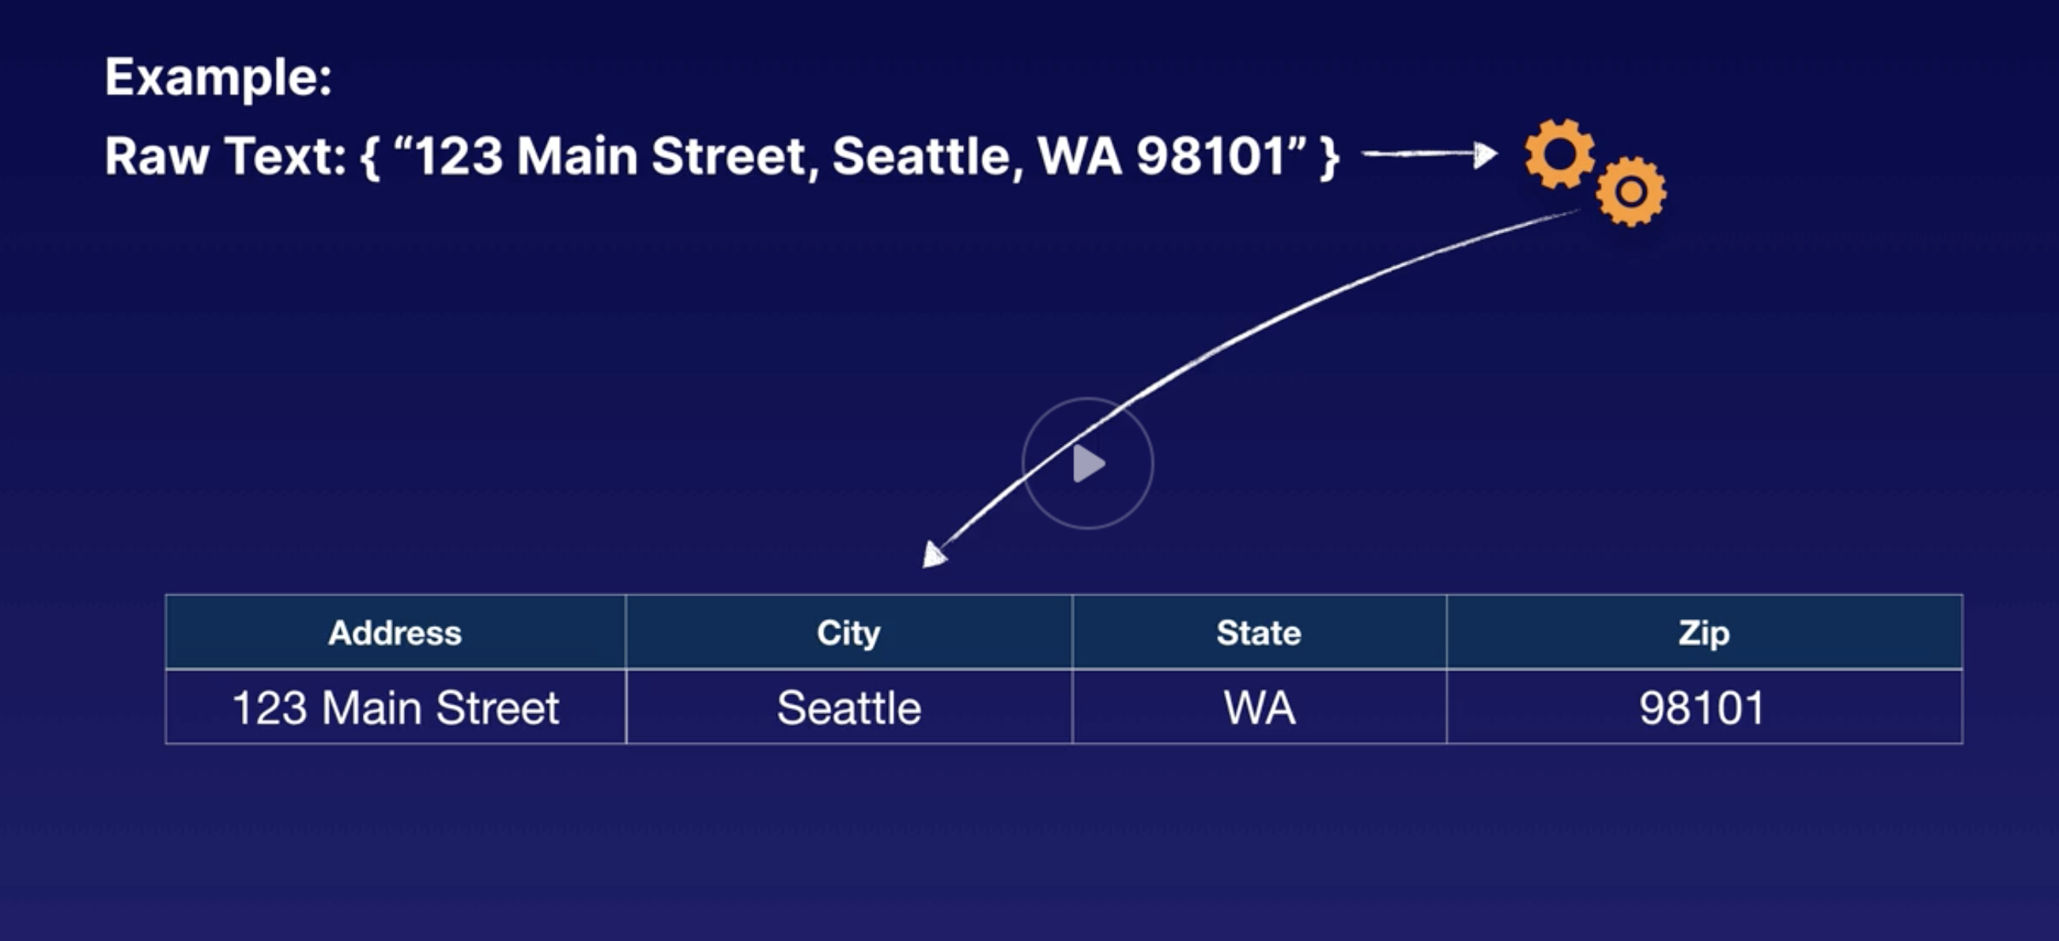
Example of text feature engineering

Slide 15
Bag of words
Tokenises raw text and creates statistical representation of the text
Breaks up text by white space

Slide 16
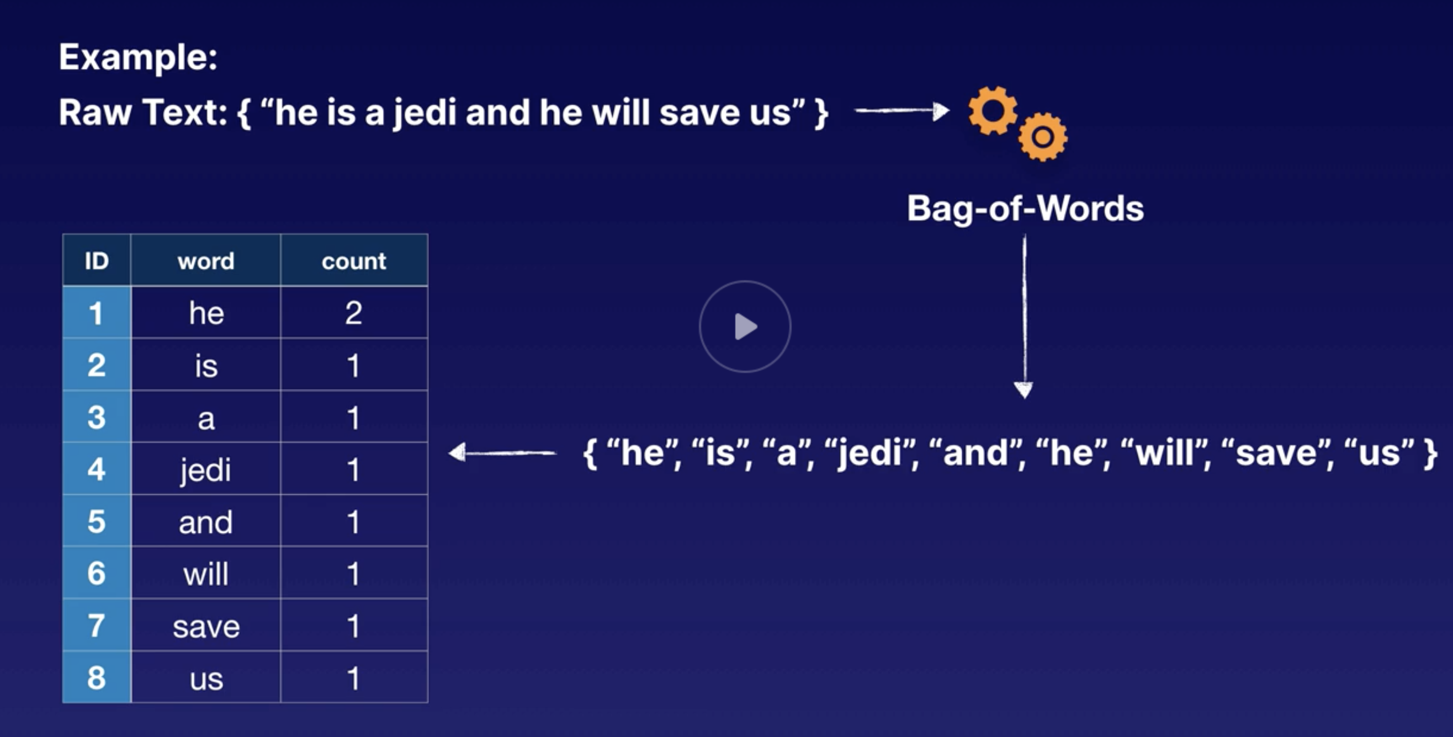
Bag o’ words example
Breaks words up that are separated by white space

Slide 17
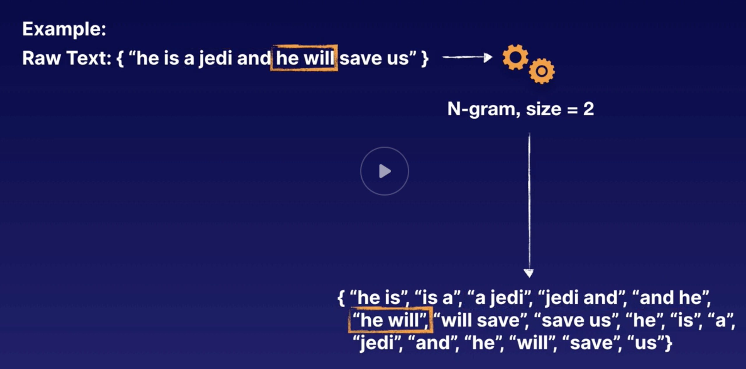
N gram
Splits sentence into words split up by whitepaces
1 gram is same as Bag 0’ words
Use case: spam filter
“click here”,
“you won the lottery”
Unigram – 1 word
Bigram – 2 word
Trigram – 3 word

Slide 18
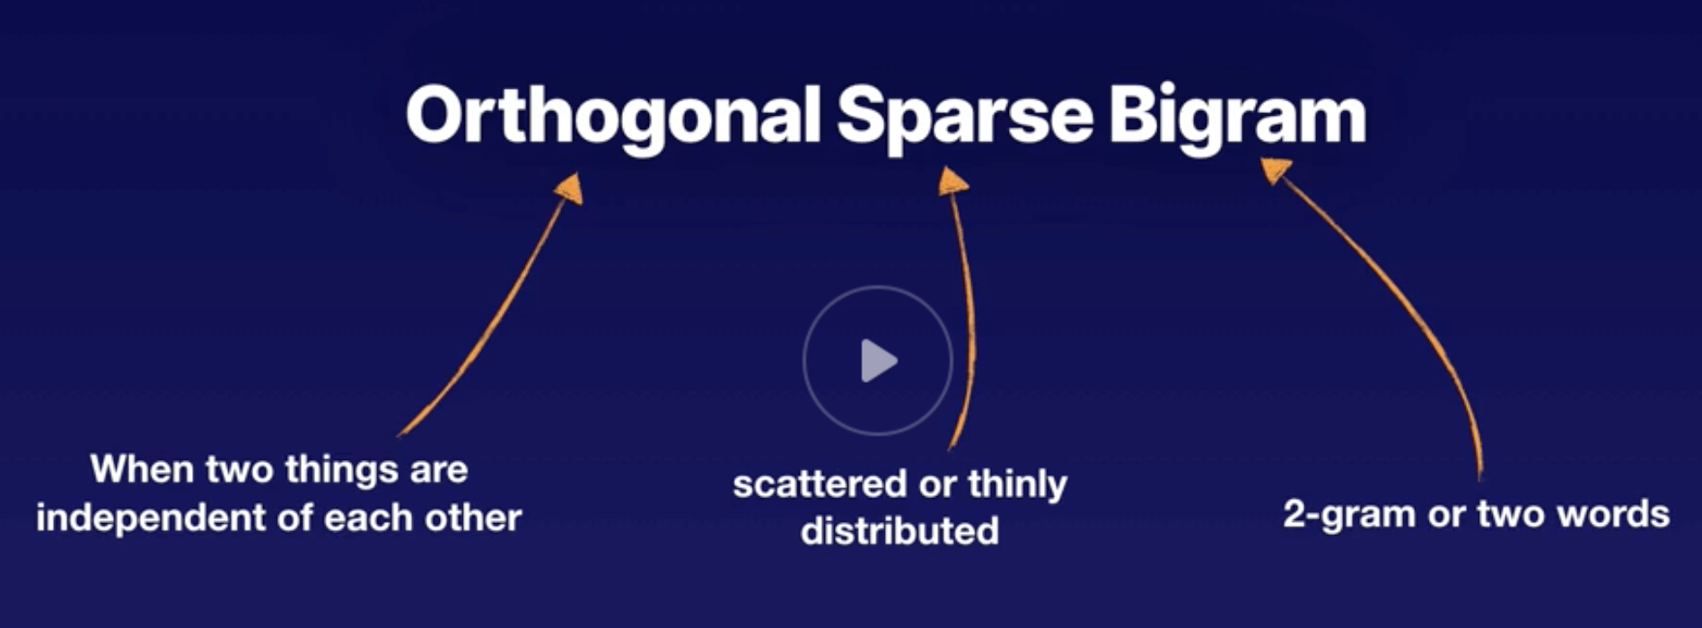

Slide 19
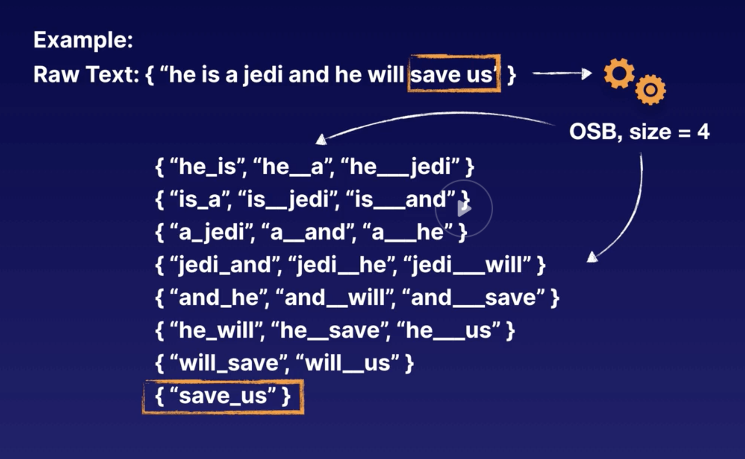
OSB in action
Highlights common words as less important

Slide 20
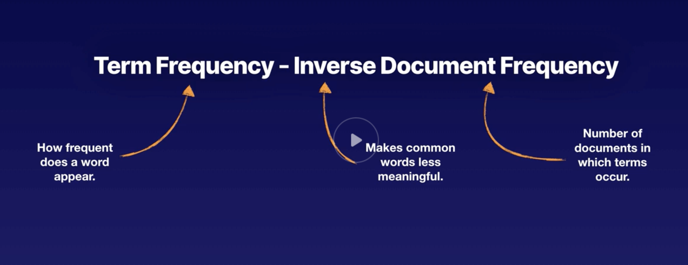
TF-IDF
Makes common words less meaningful
For e.g. the, and

Slide 21
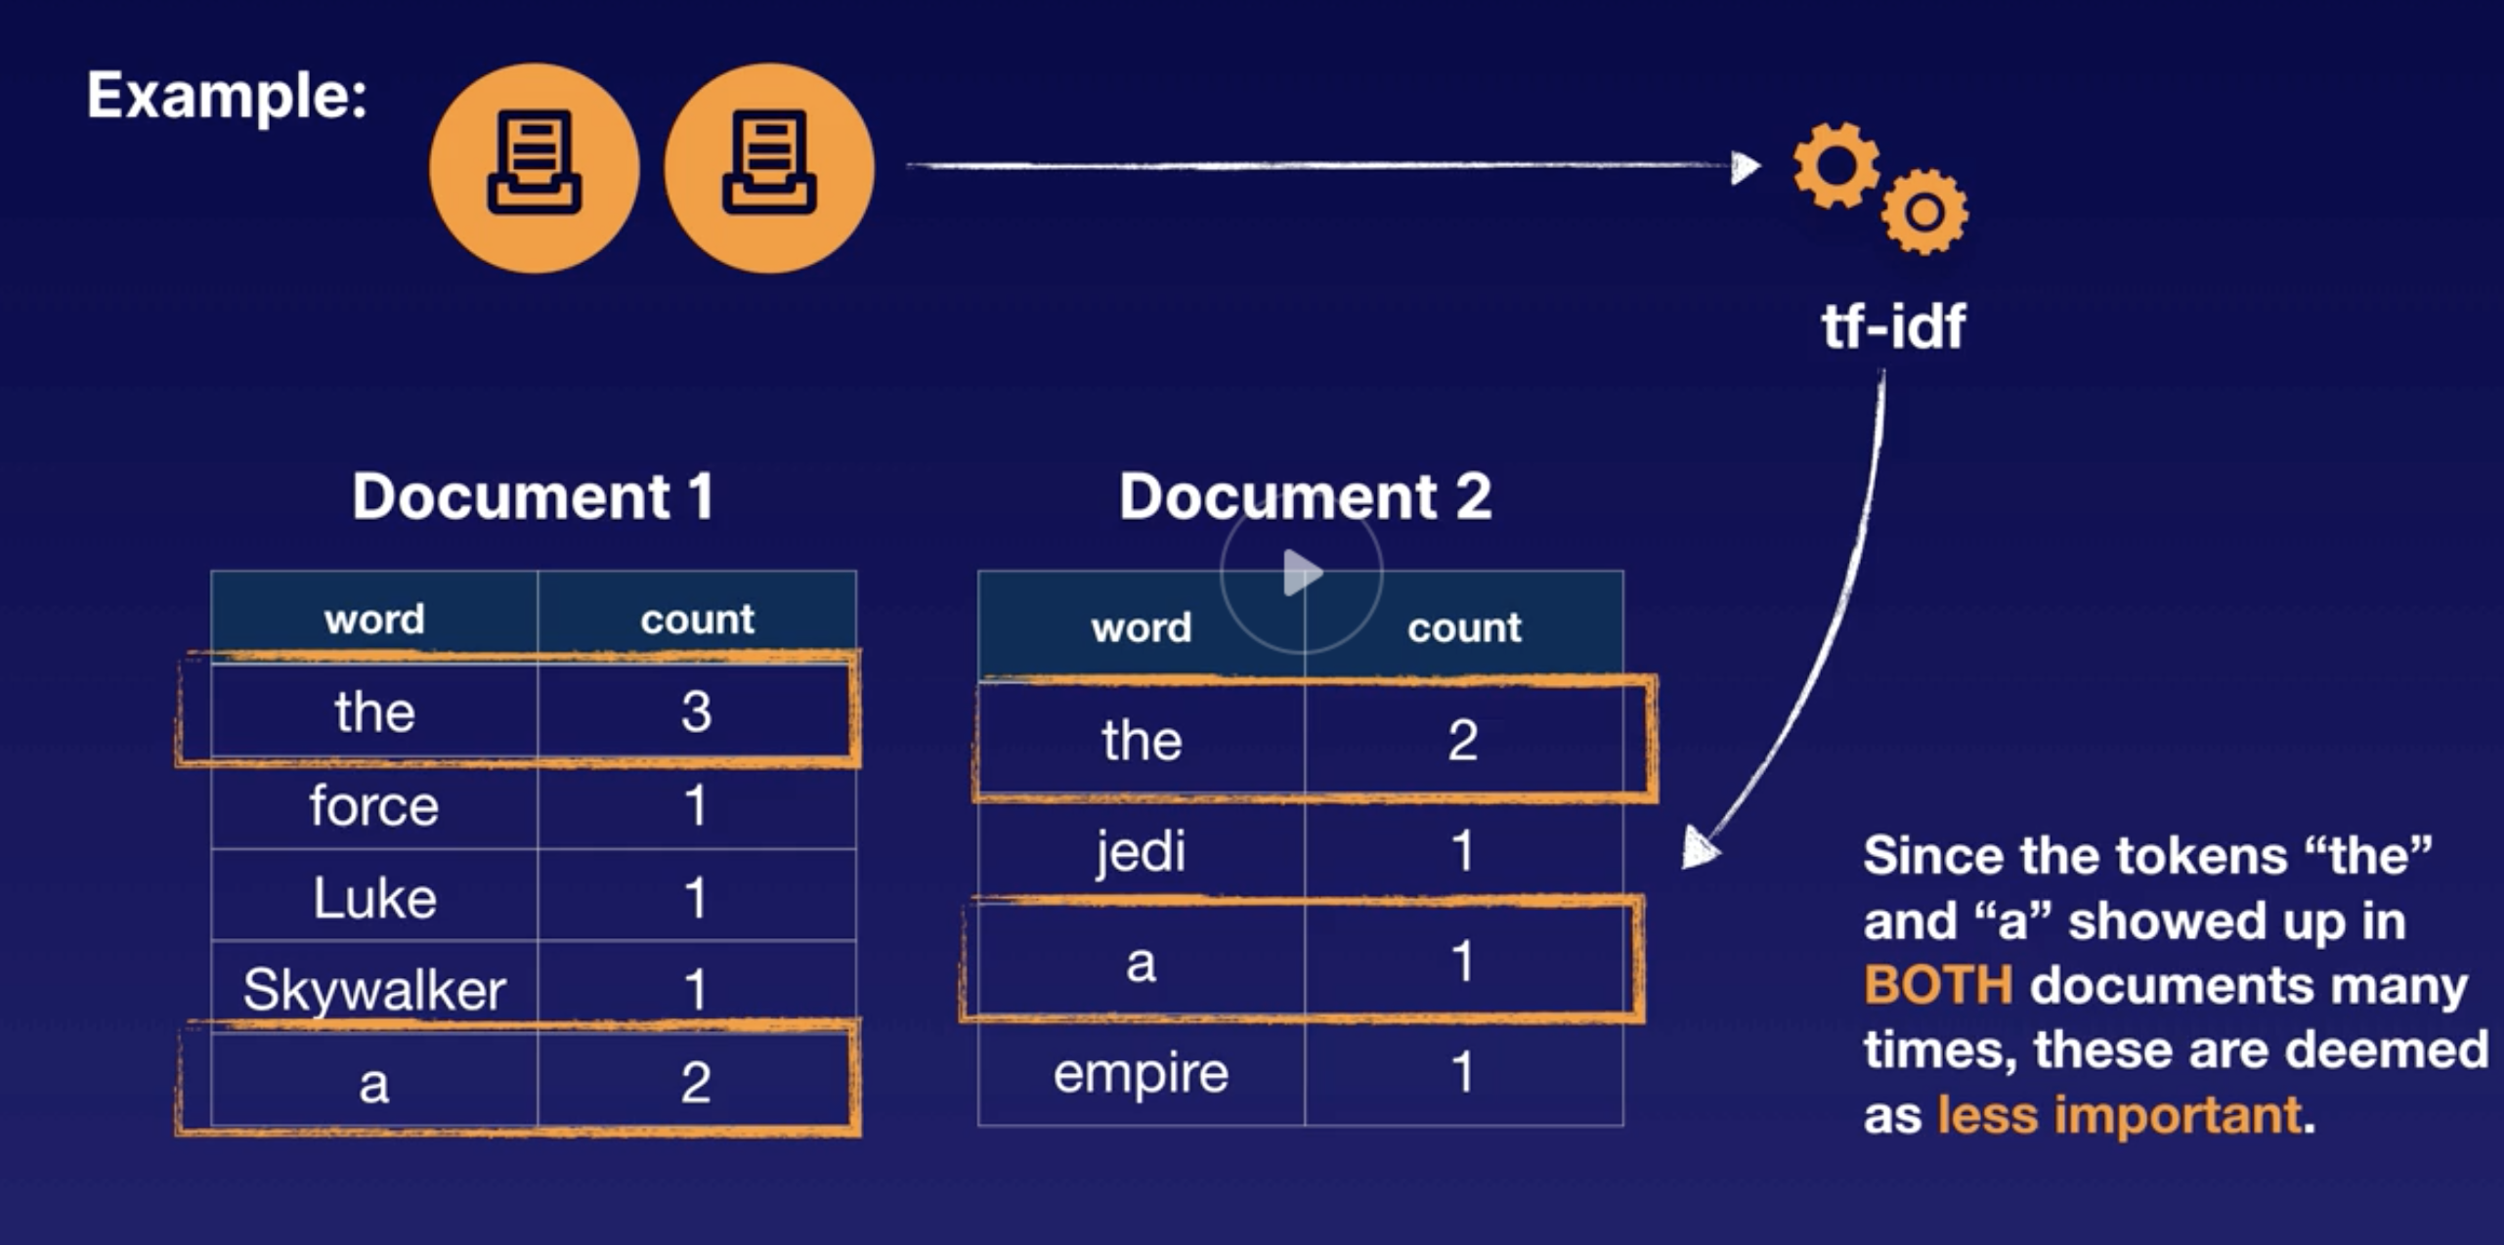
TF-IDF

Slide 22
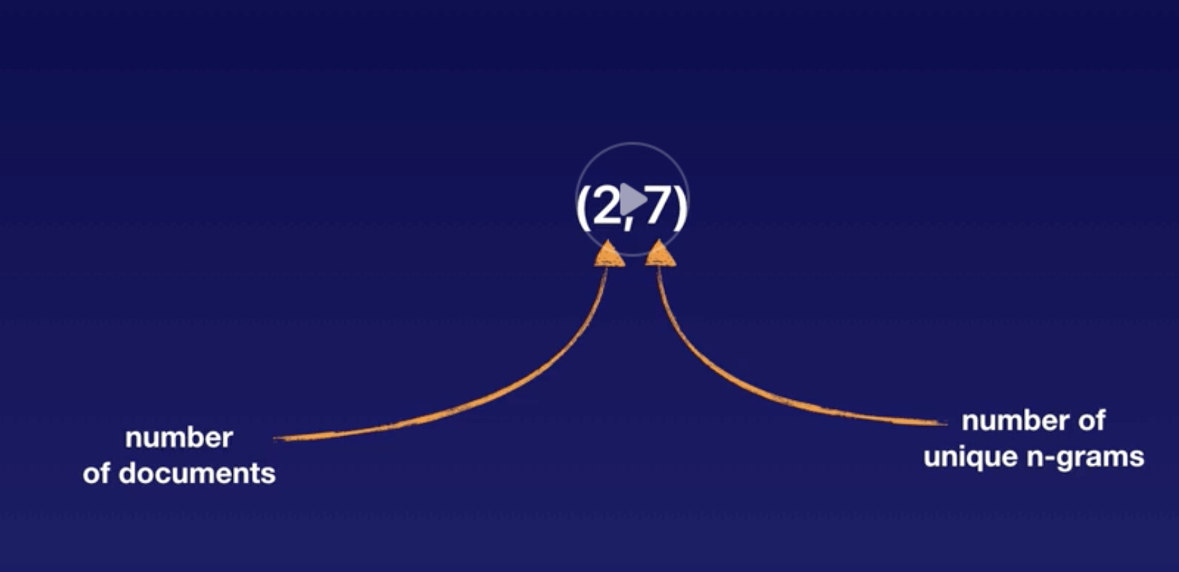
Vectorizing TF-IDF

Slide 23
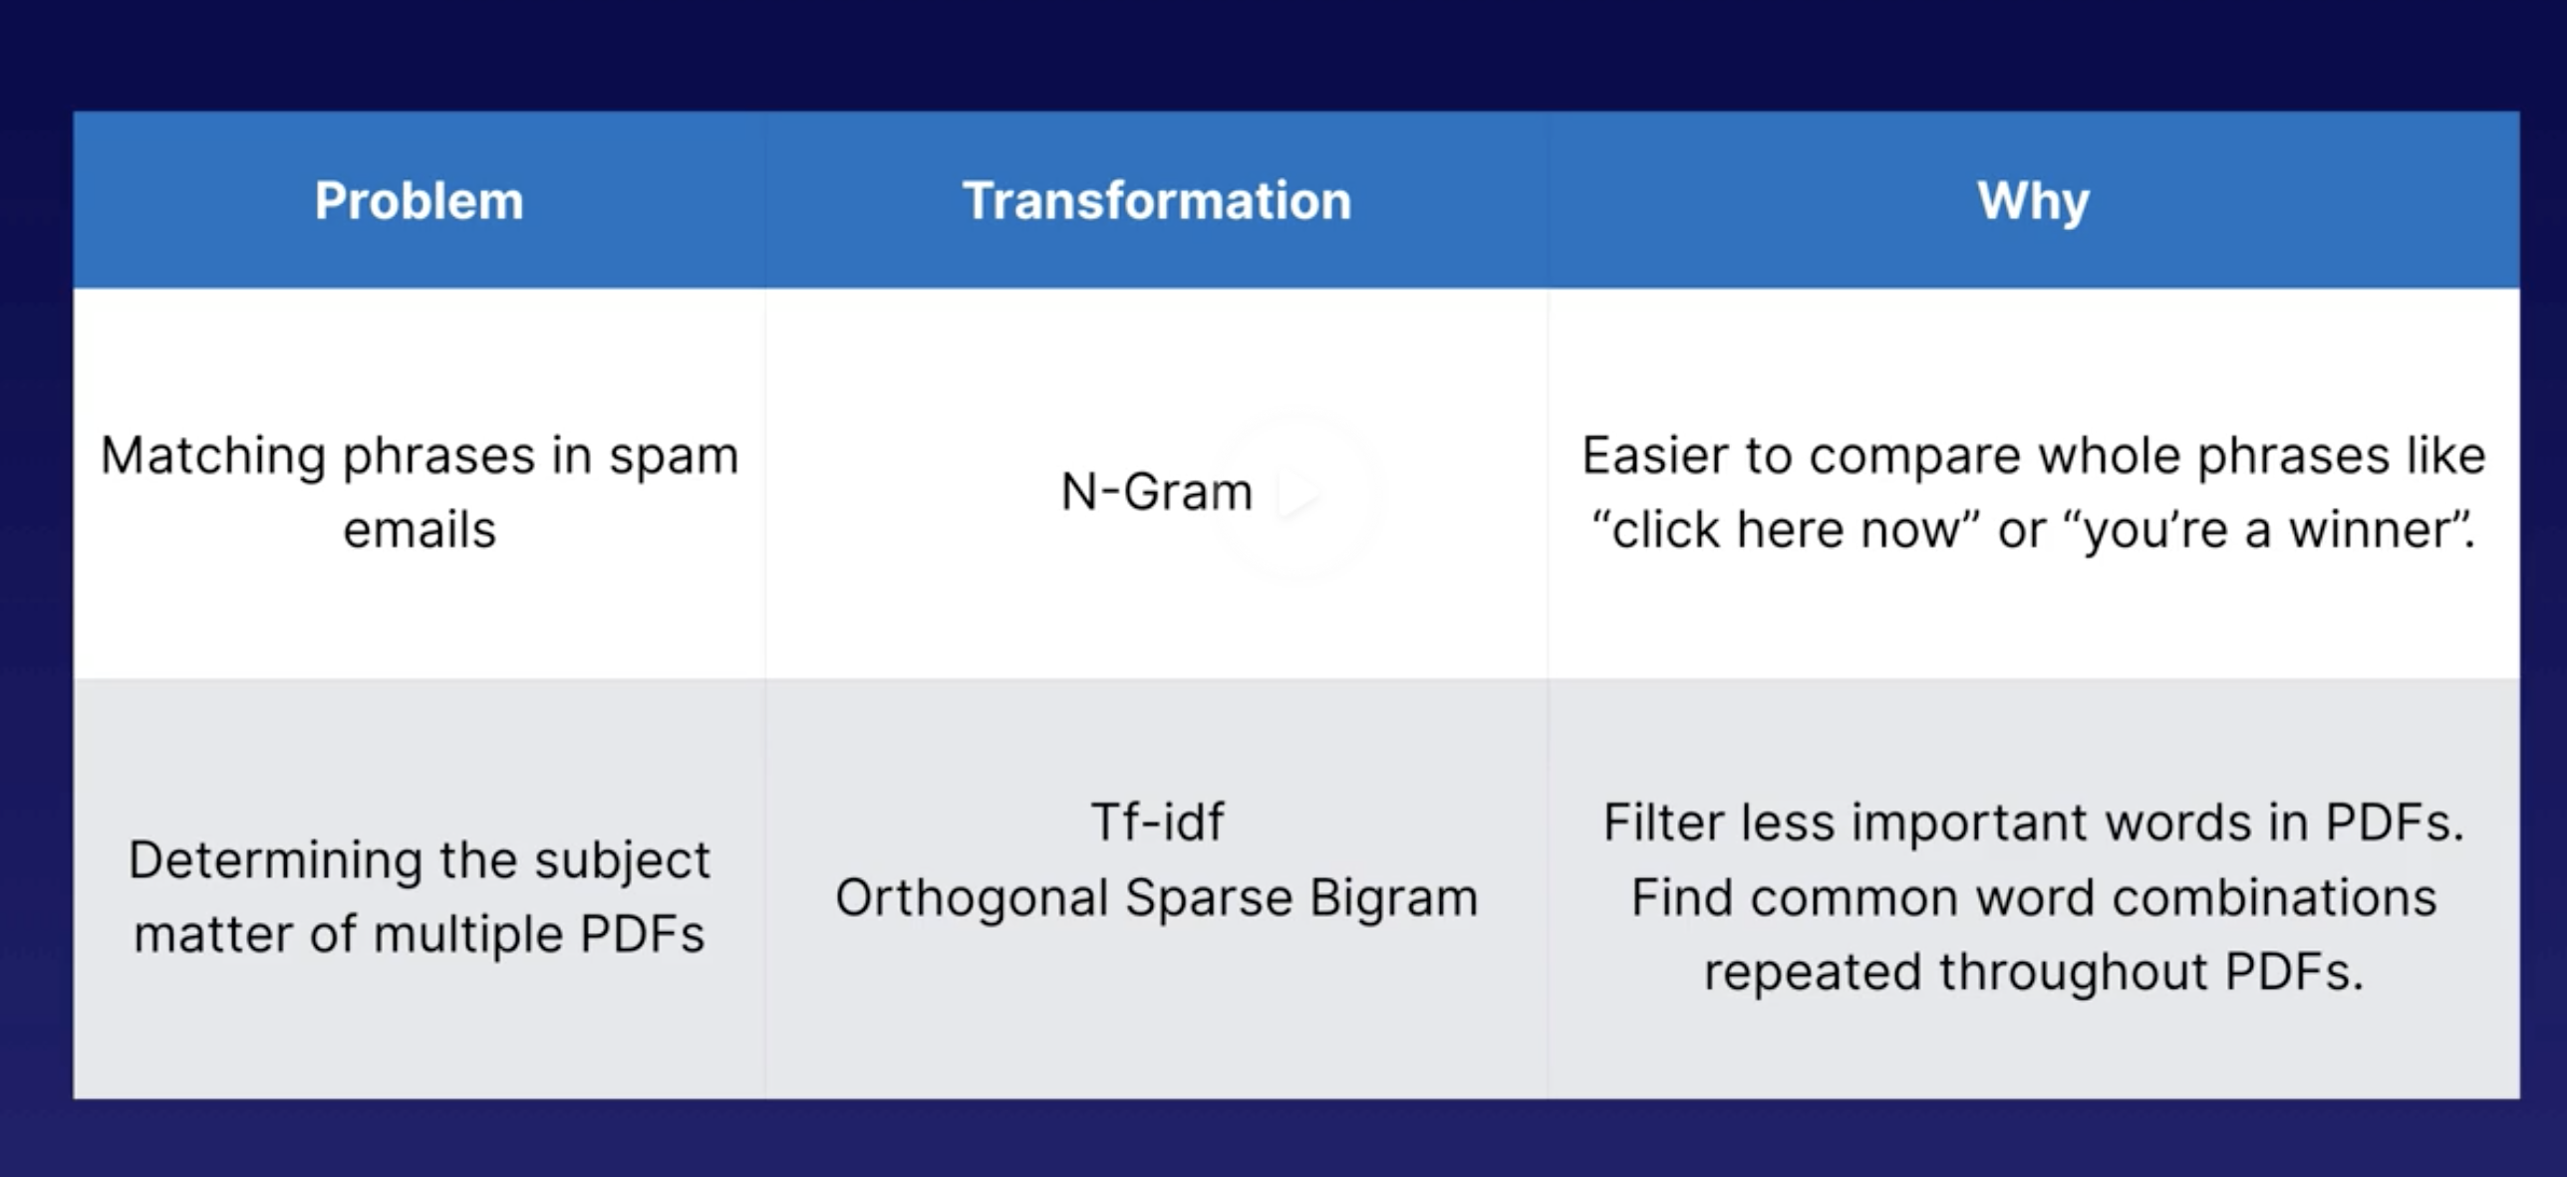
Use cases

Slide 24
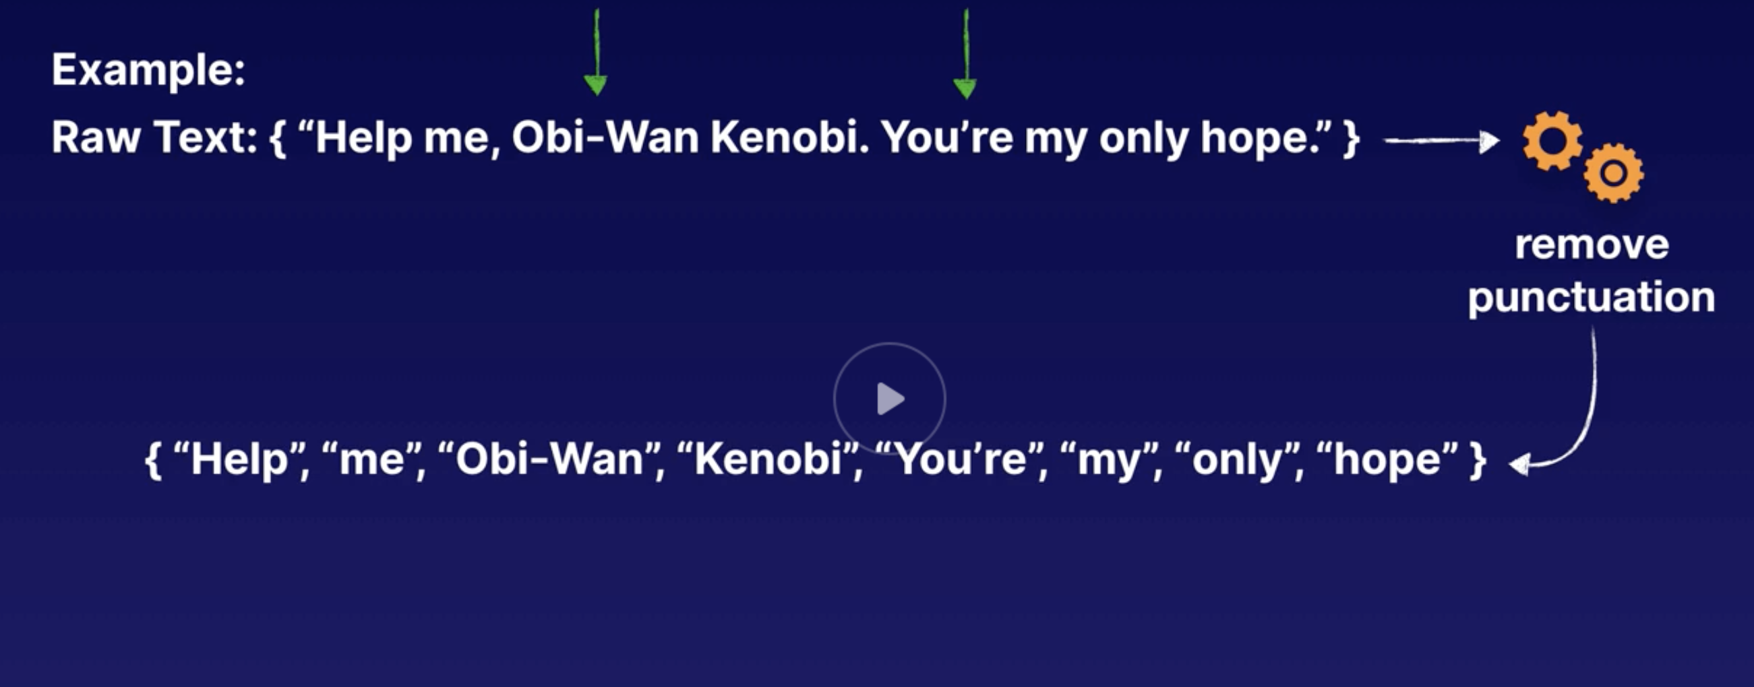
Removing punctuation

Slide 25
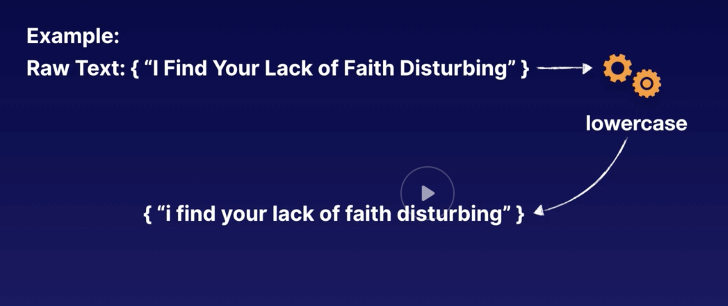
Lowercasing
Standardization

Slide 26
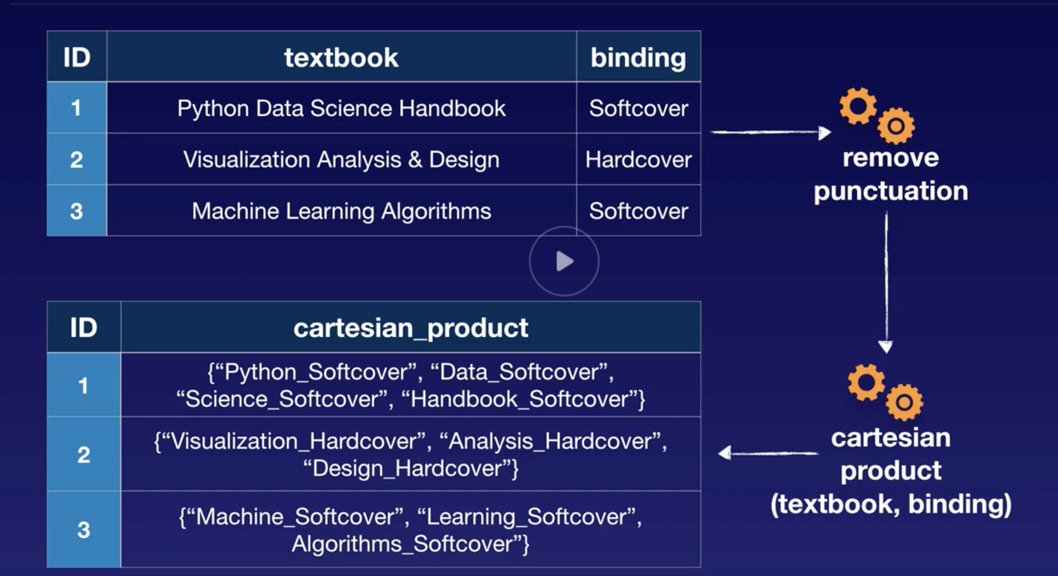
Cartesian product transformation
Combining words together. See example below

Slide 27
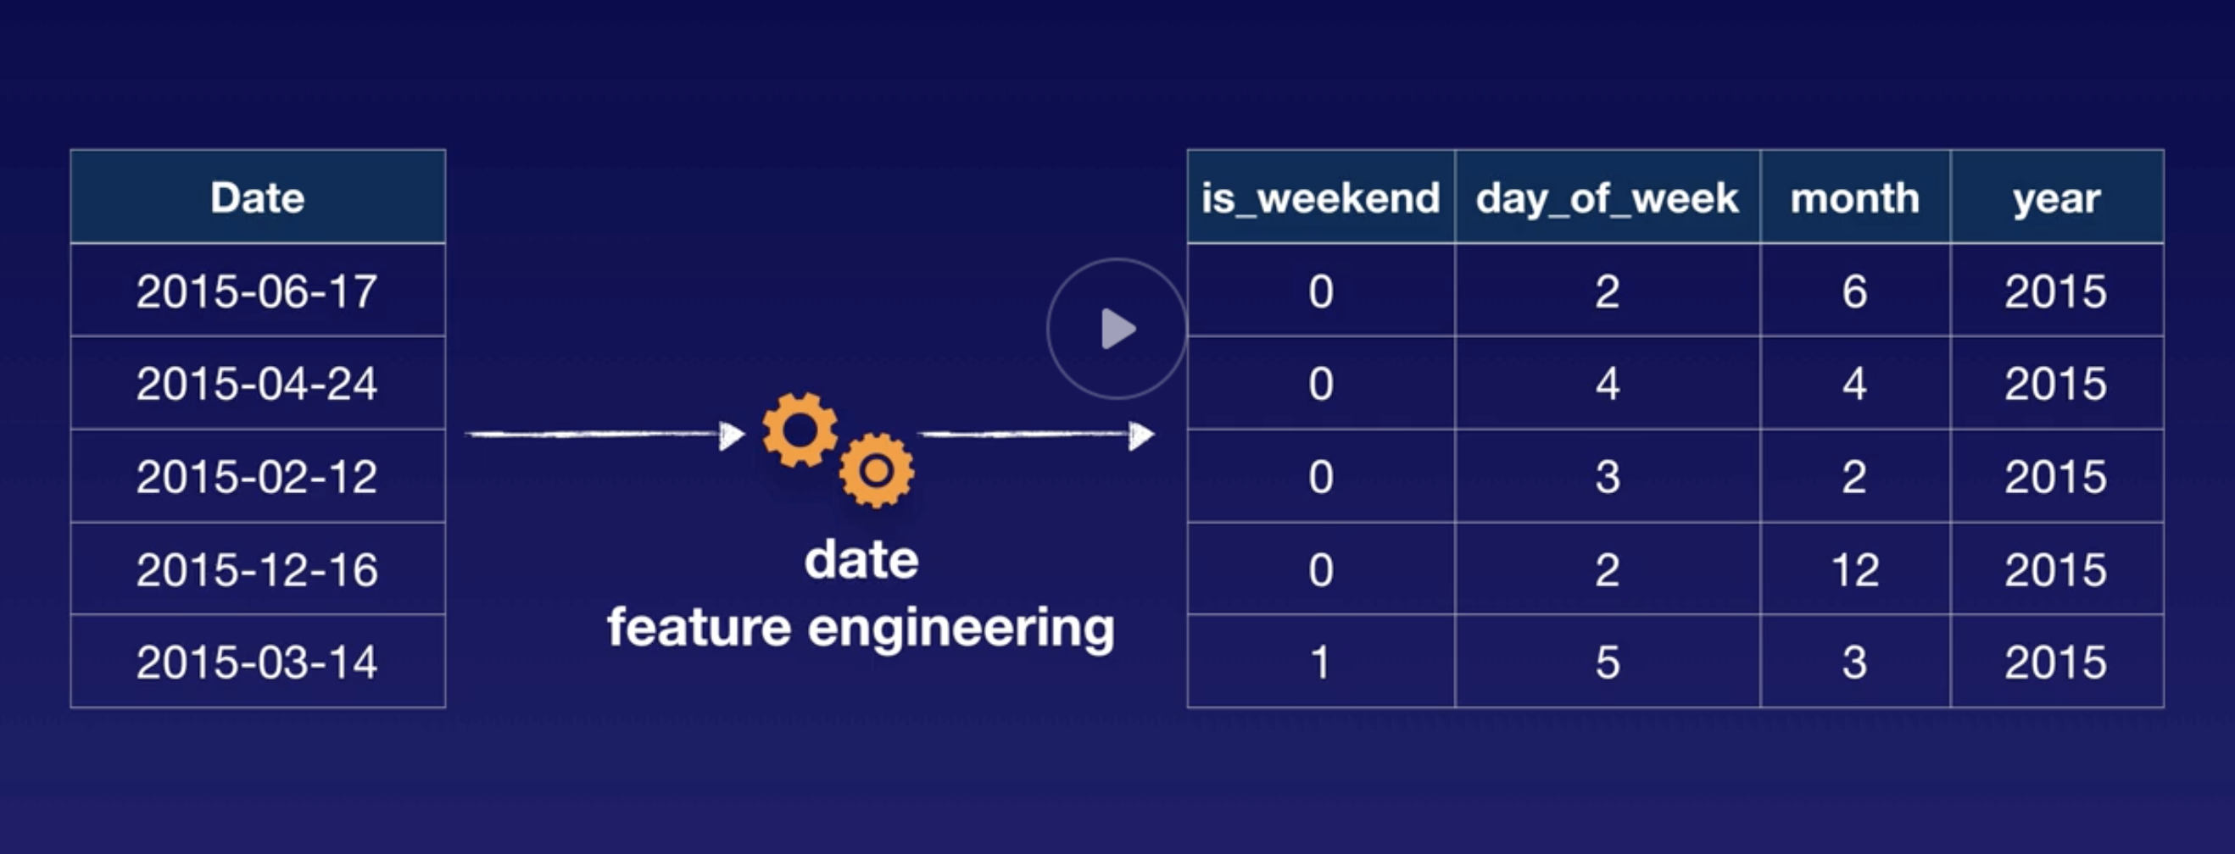
Feature engineering dates
Extracts meaningful information from mere dates

Slide 28
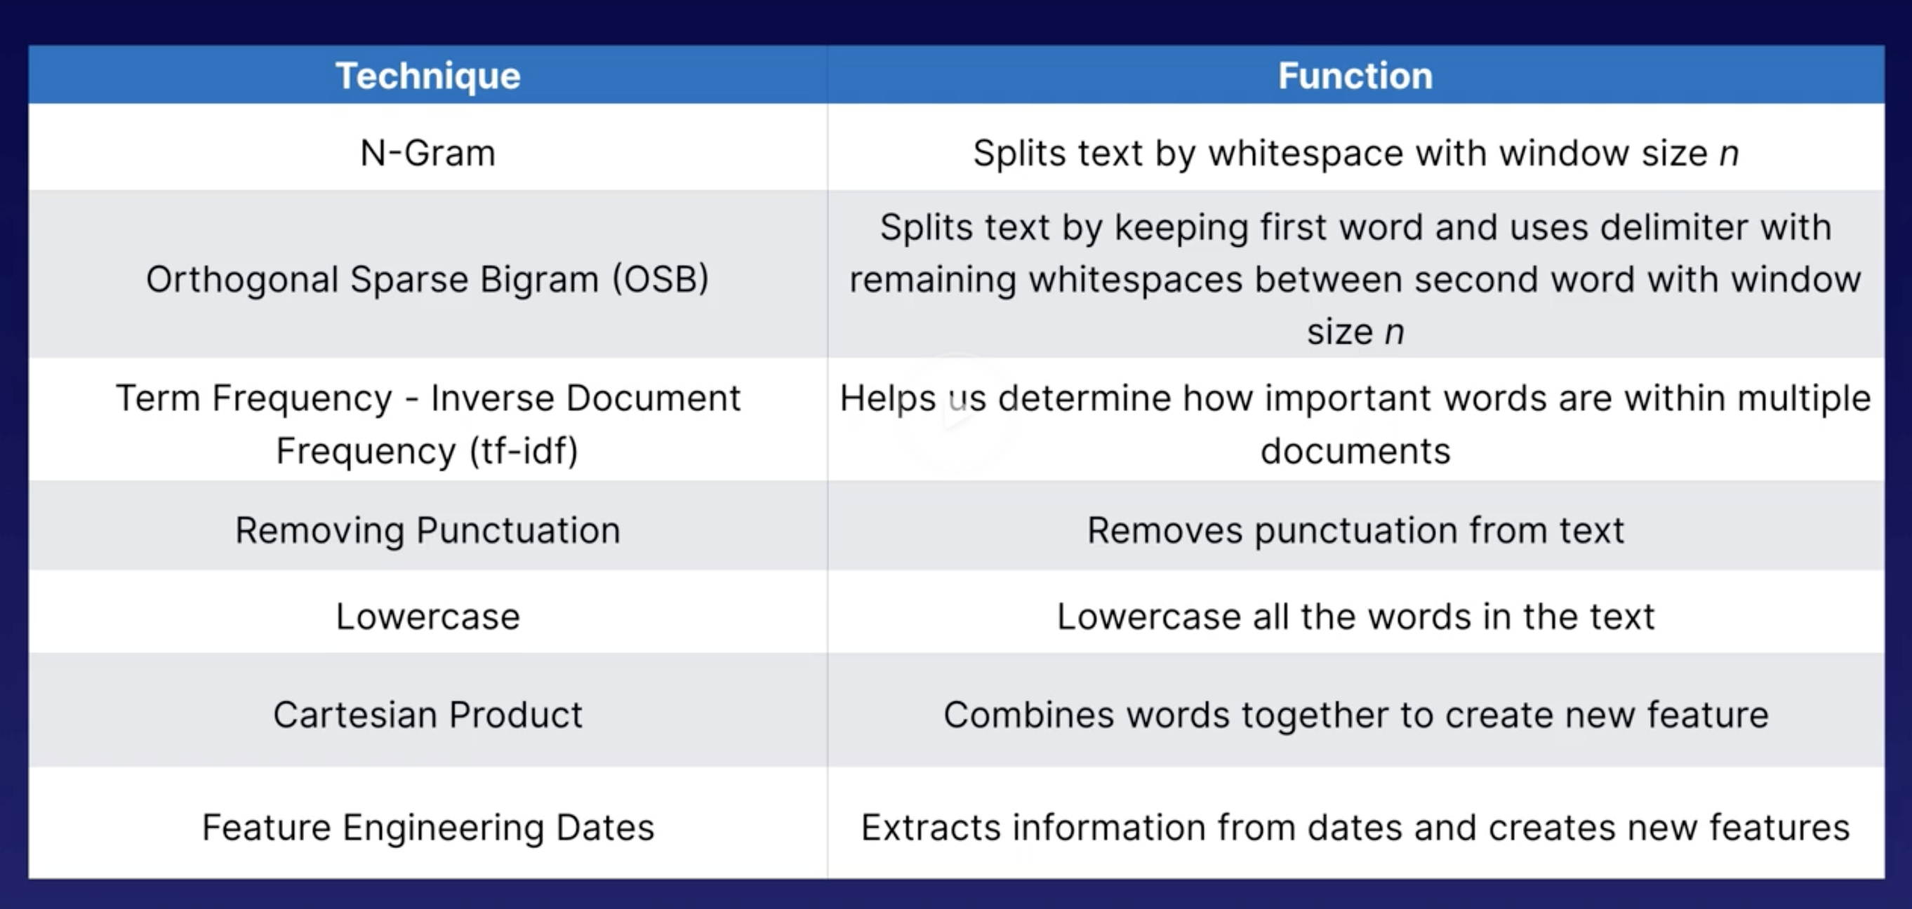
Text engineering function comparison

Slide 29
Numeric feature engineering
To make it east for algorithms to analyze data
Feature scaling: changing values so all are on same scale
Normalizations
Standardizations
Binning: changes values into groups or buckets
Quantile binning: assign same number of features to each bin

Slide 30
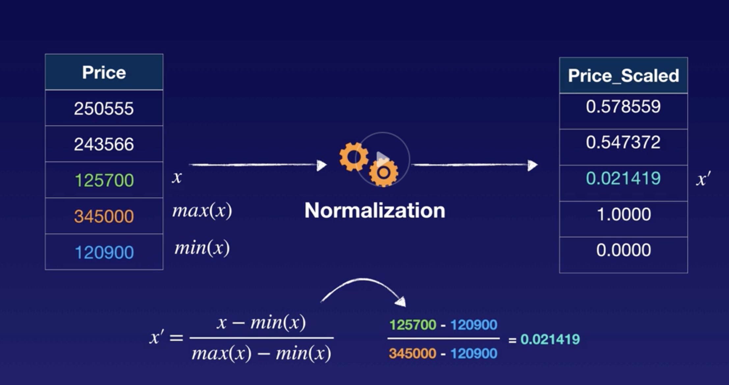
Normalization example
Scaling down: outliers can throw off this though

Slide 31
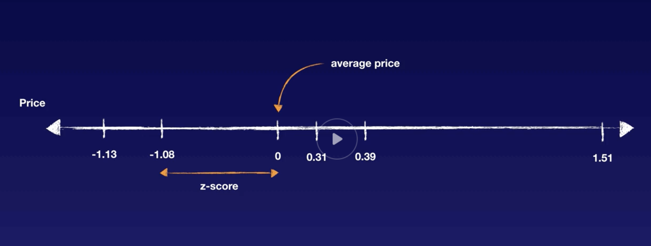
Standardization
Makes average zero
Zscore used for remainder values

Slide 32
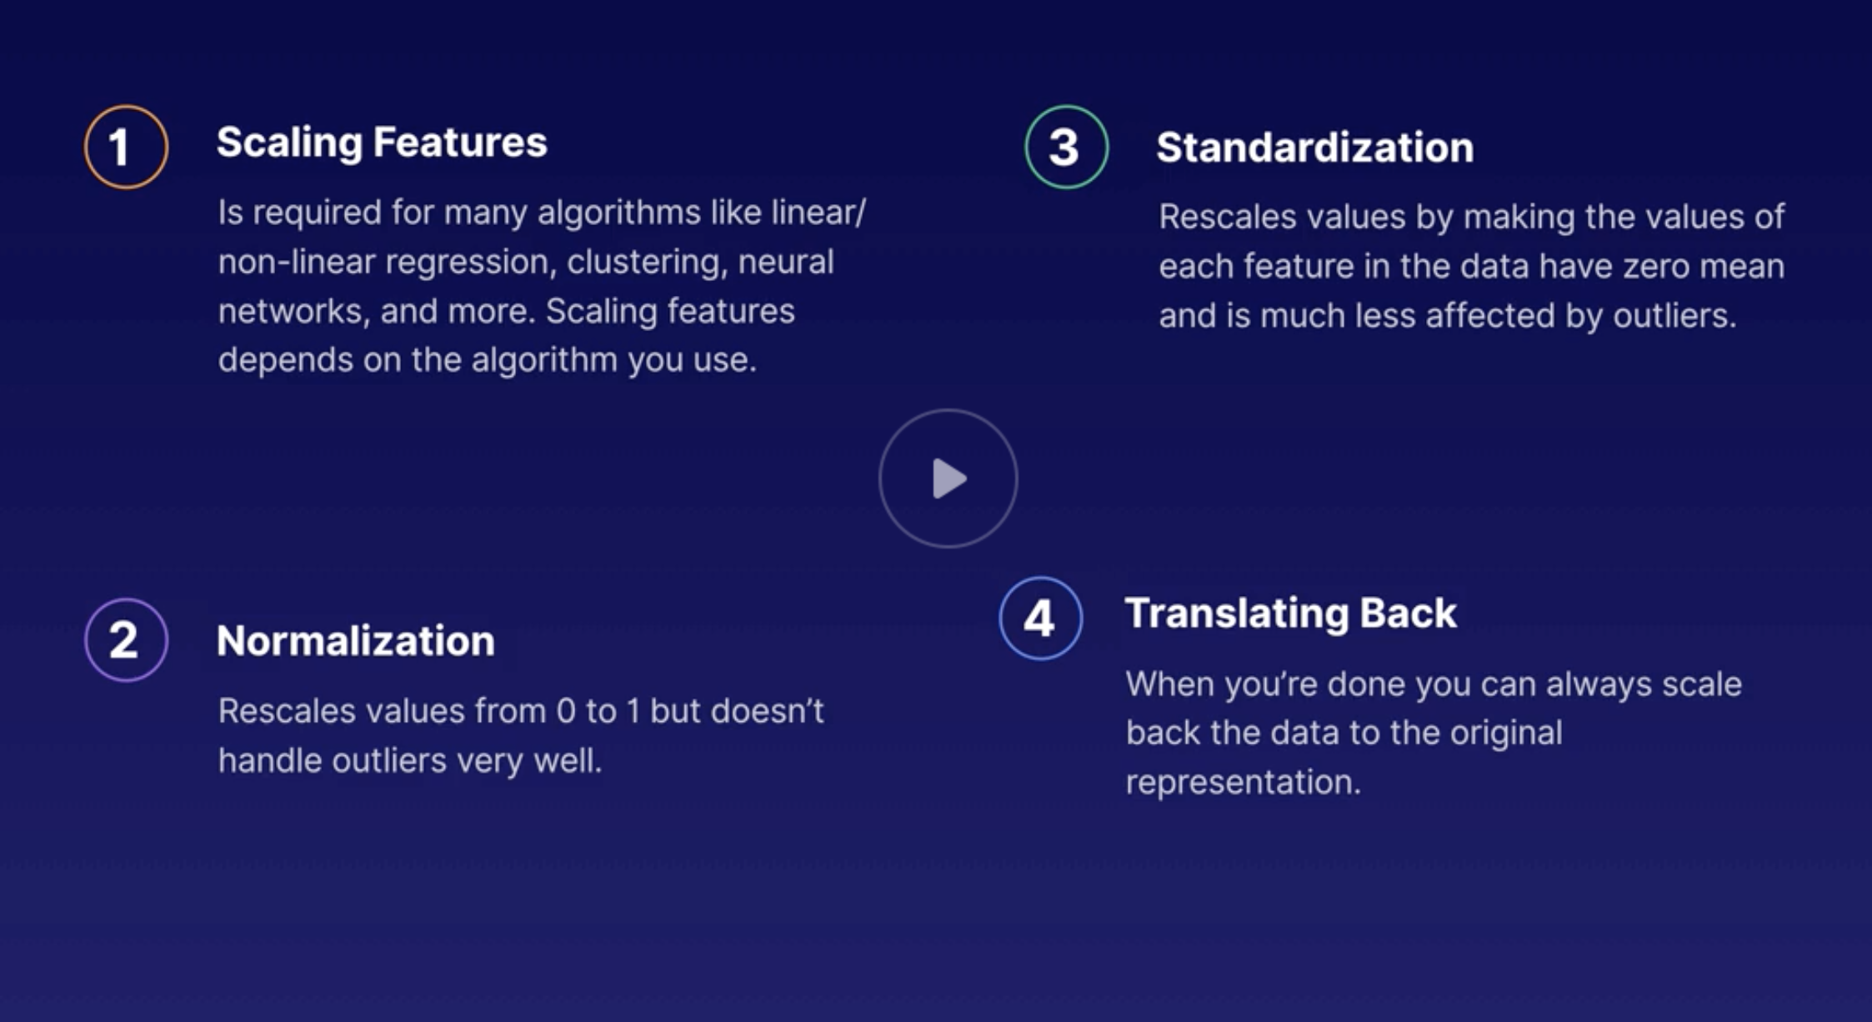

Slide 33
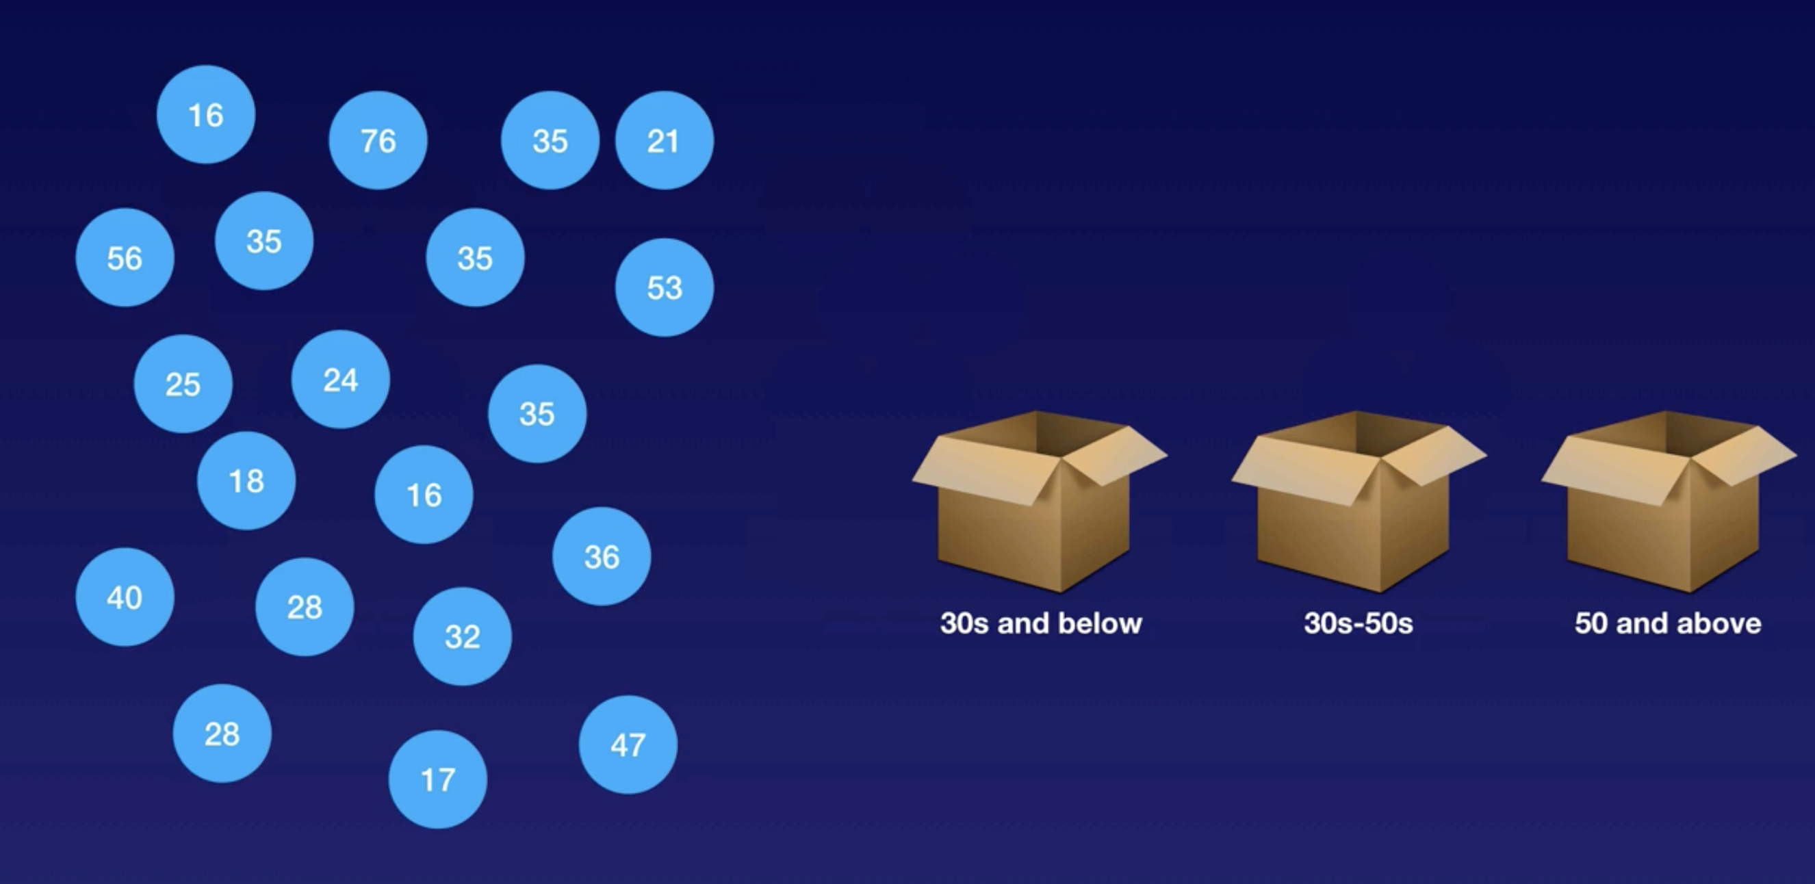
Binning
Use case: persons age group

Slide 34
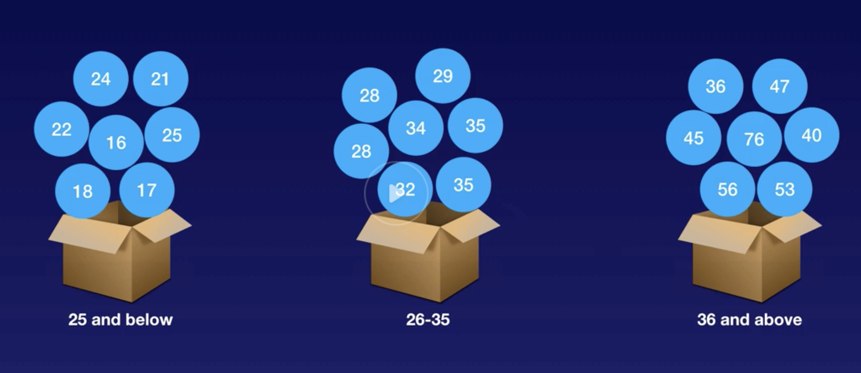
Quantile binning
Standard binning can result in bins with unequal number of values
Quantile binning re adjusts the bin ranges

Slide 35
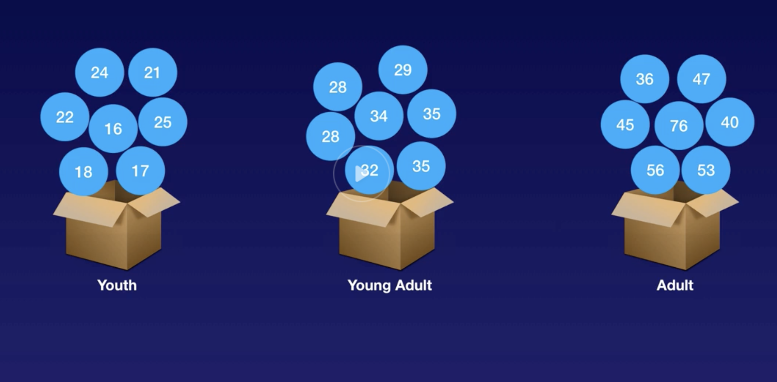
Categorization

Slide 36
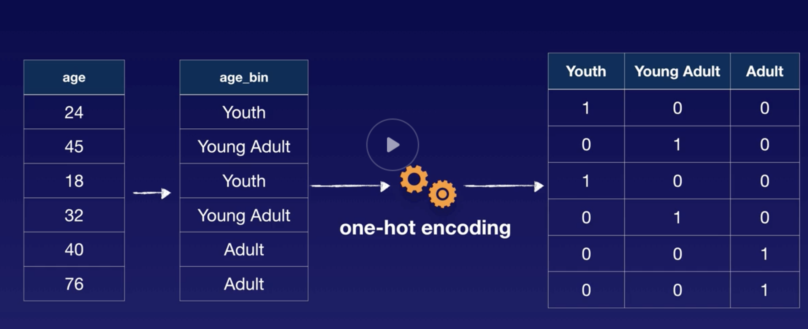
One hot encoding (making feature types)

Slide 37
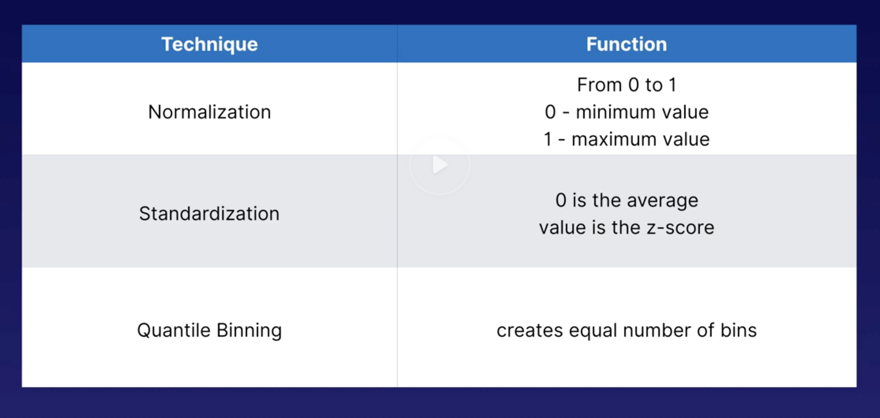
Summary

Slide 38
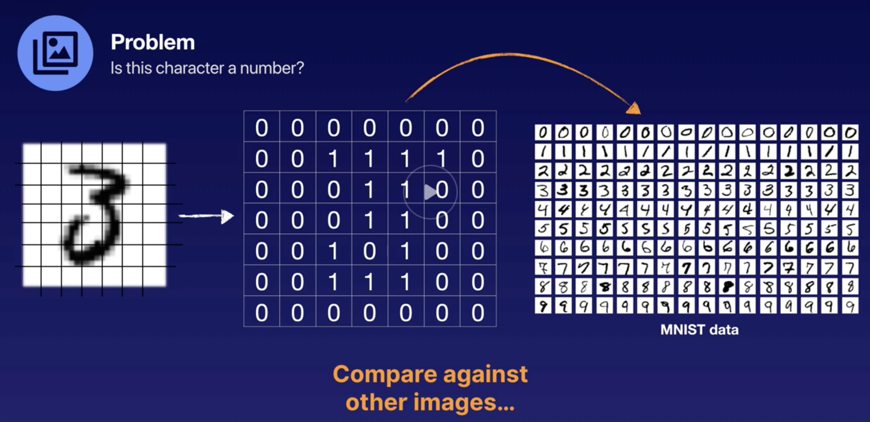
Image feature engineering
Extracting useful info from images
E.g.

Slide 39
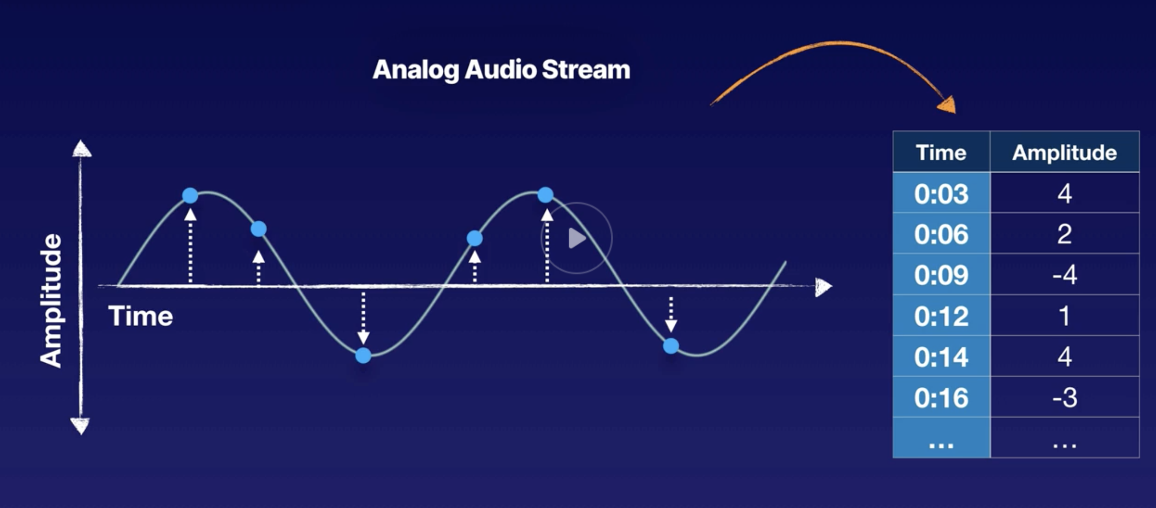
Audio feature engineering
Extract useful info from audio and sounds
E.g.

Slide 40
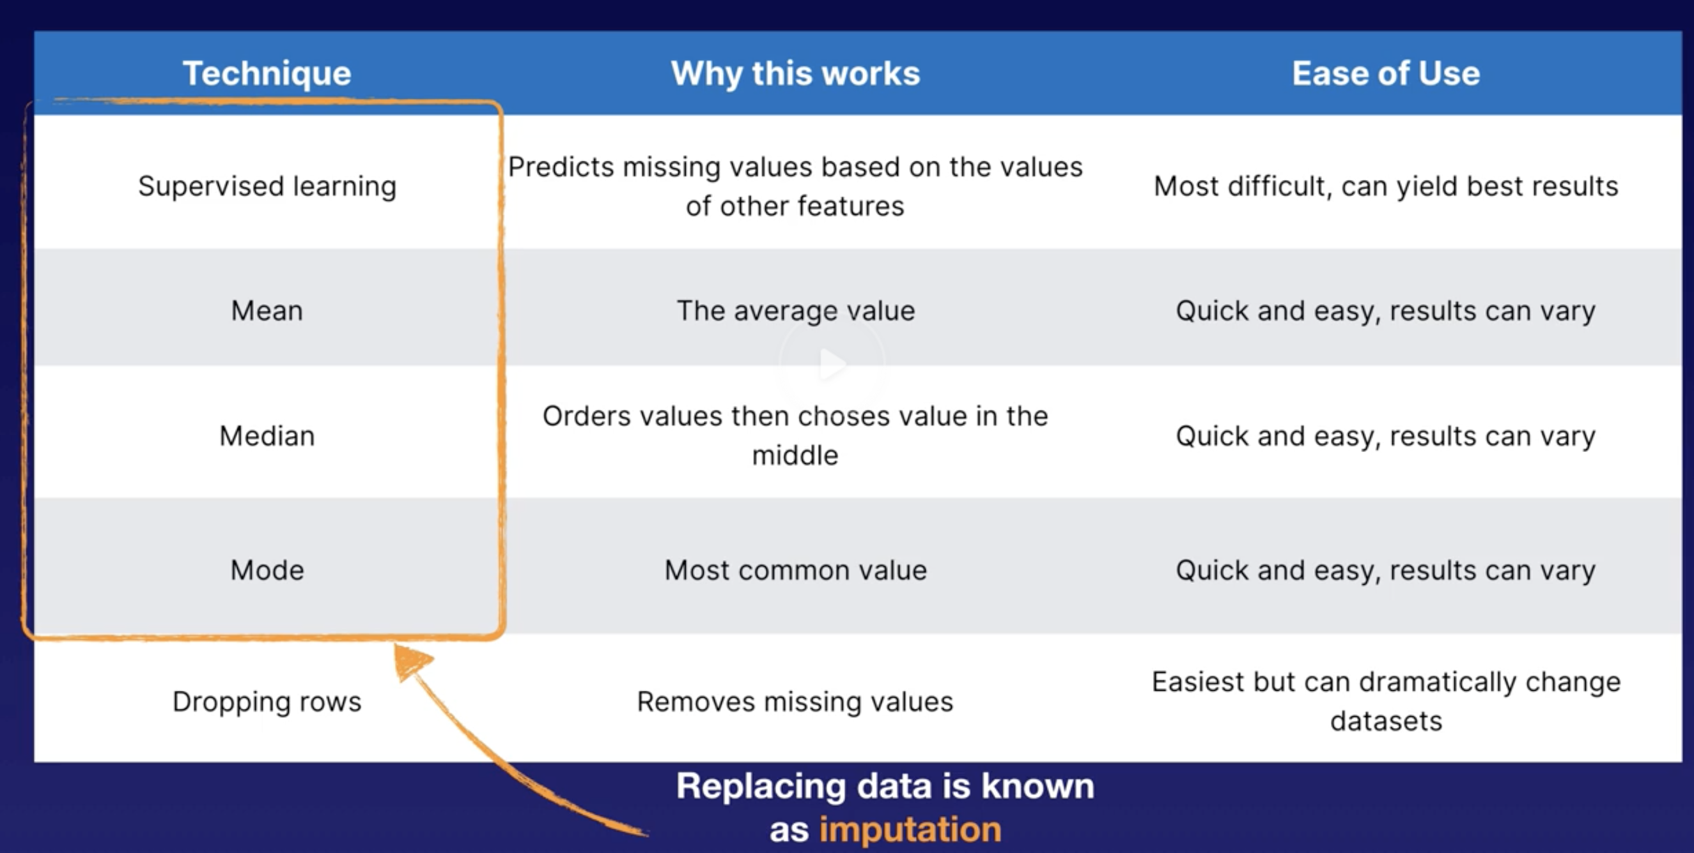
Handling missing values
Missing data values can skew results
E.g null, NaN, None

Slide 41
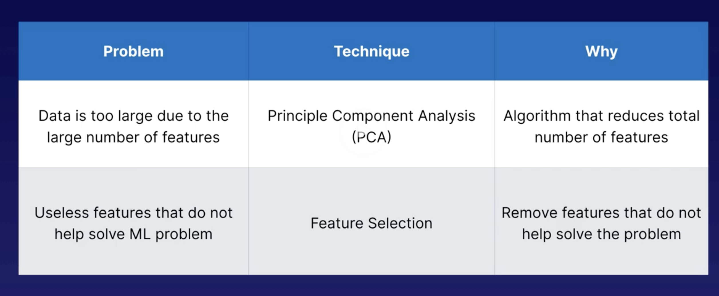
Feature selection
Selecting most relevant features to prevent over complicating analysis
Types:
Manual: done intuitively by humans
Unsupervised: Principal Component Analysis – reduces number of features while retaining as much information as possible

Slide 42
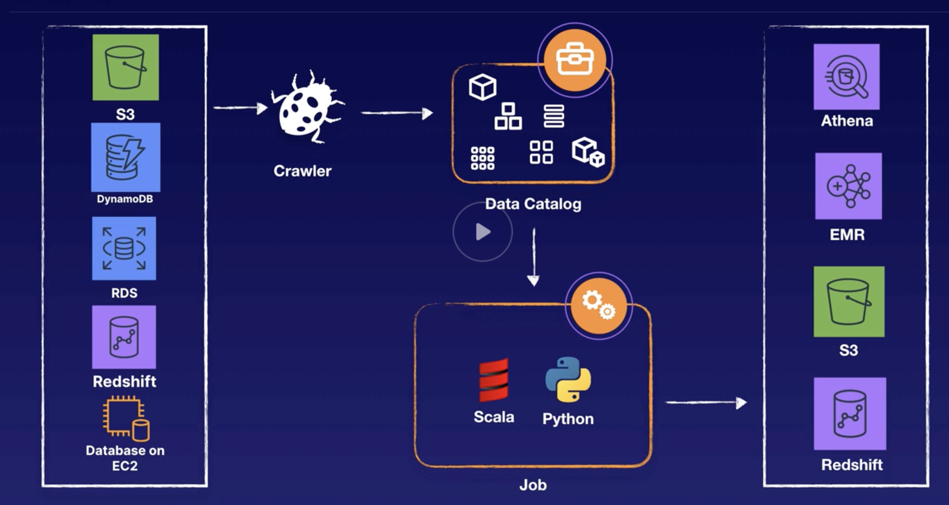
Helper Tools
AWS Glue – fully managed ETL allows you run Python, Scala, run jobs on demand, or schedule or trigger.

Slide 43
AWS Glue
It consists of Data Catalog –
crawlers (classifiers) and databases
ETL – Jobs (on demand, on schedule)
Types – Spark (default) – Python or Scala
Python – will generate code for you
If you want to write your own script - Choose python shell for traditional python coding using numpy, it lets you choose supporting libraries – numpy, pandas
Endpoints
Allows you to create Notebooks – zeppelin or jupyter to do transformation

Slide 44
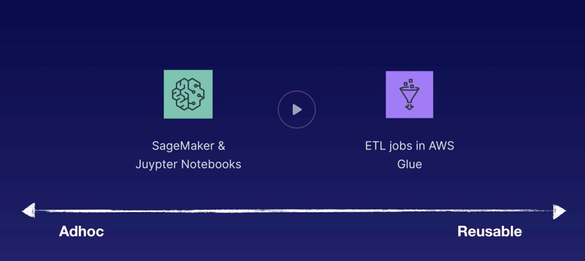
Sagemaker
Helps with:
Data preparation, build, train model
You can spin up jupyter notebook instances which has access to the libraries needed

Slide 45
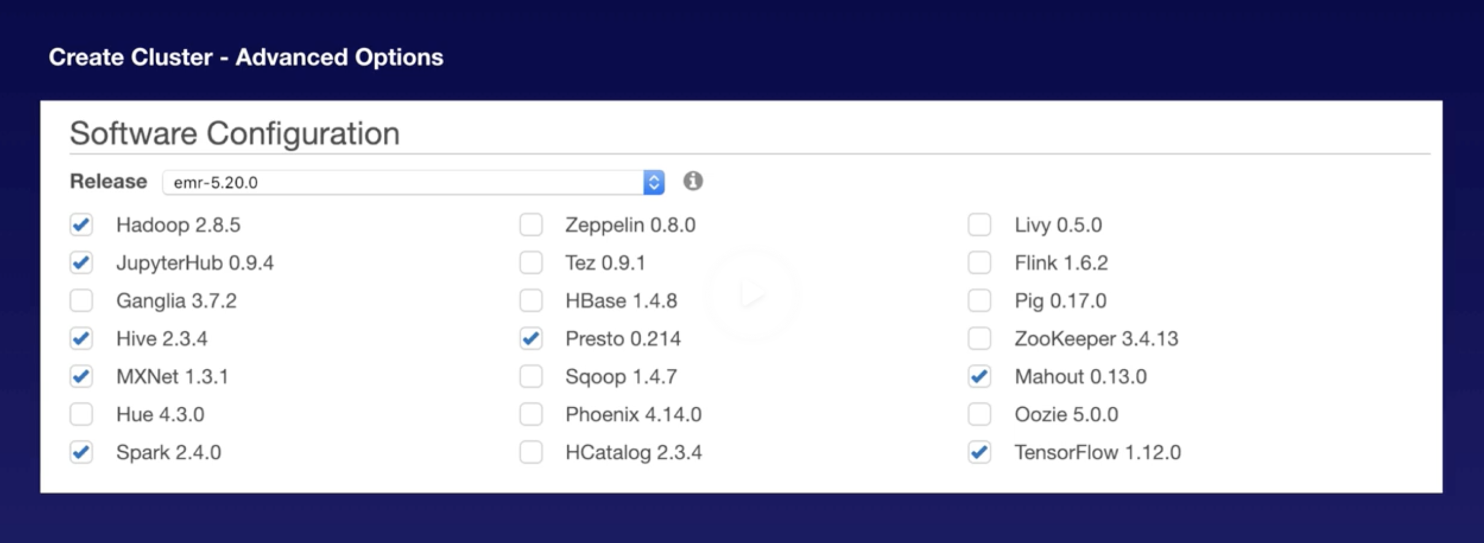
EMR
Fully managed Hadoop cluster
We have to manage the ec2 though
In AWS glue, infra is managed – this is the easiest option for ETL jobs
EMR data can be integrated with Sagemaker using Apache spark

Slide 46
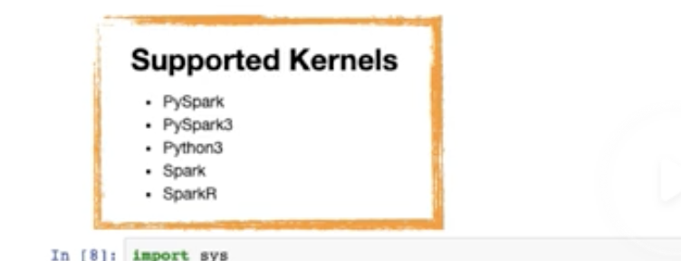
EMR
Jupyter is built into EMR
Supported kernels

Slide 47
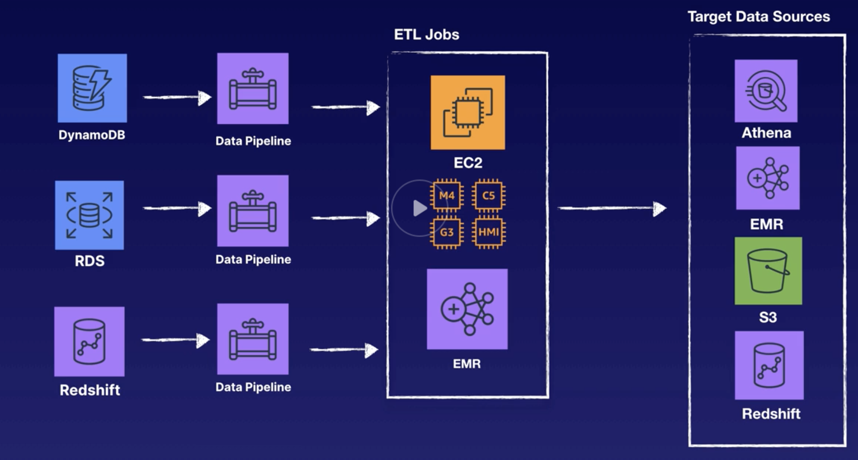
Athena and Datapipeline
Athena - You can create a catalog and DB on Glue and query it from Athena
Datapipeline – process and move data between AWS compute services

Slide 48
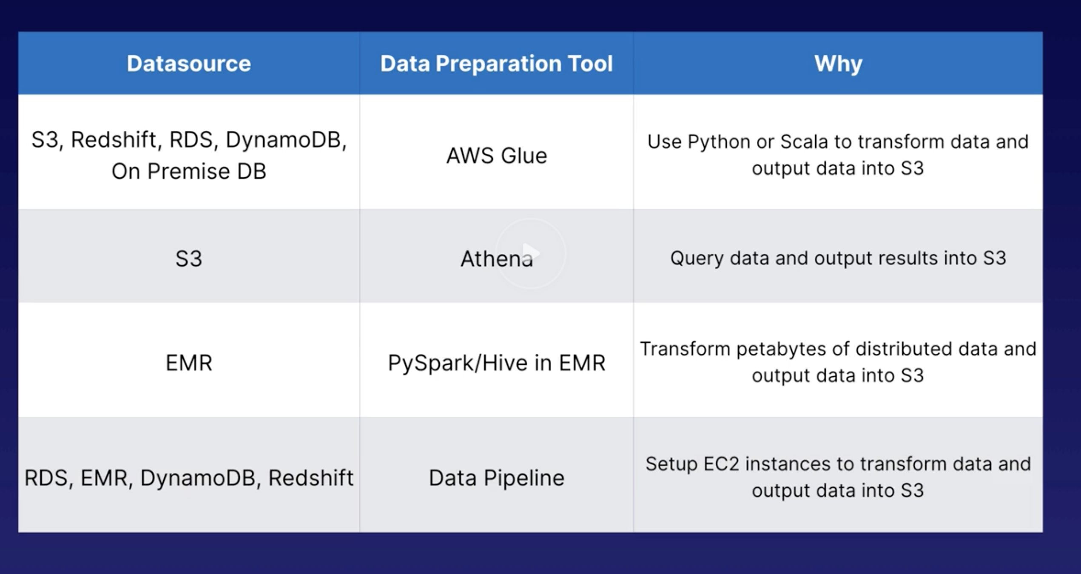
What tool to pick?

